Slide 1
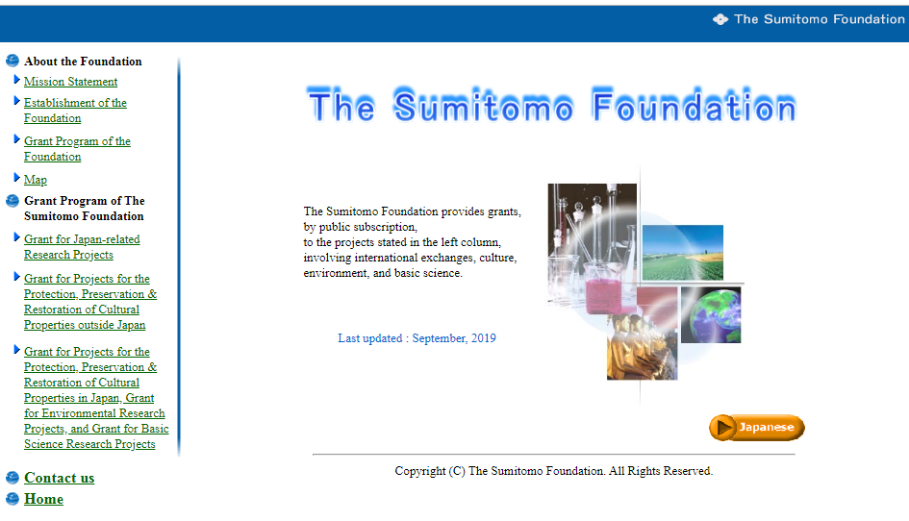
http://www.sumitomo.or.jp/e/

Slide 2
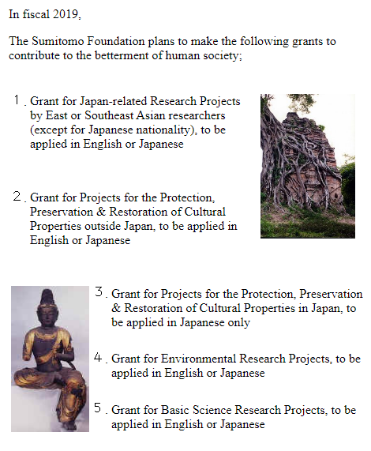
Grant Program of the Foundation

Slide 3
Grant for Japan Related-Research Project
1. Purpose of the Program
The program aims at enhancing mutual understanding between Asian countries and Japan through promoting research projects in the field of the social sciences or humanities that are related to Japan
The program aims at enhancing mutual understanding between Asian countries and Japan through promoting research projects in the field of the social sciences or humanities that are related to Japan.
3. Qualification of Applicant
2. Eligible Projects for Application
Researcher shall be of Southeast or East Asian (non Japanese) nationality, living outside Japan. Awarded researcher must conduct the proposed research by himself or herself.
Any research project to be carried out by individual or a group in the field of the social sciences or humanities that is related to Japan.

Slide 4
Eligible Projects
Application Guide
1. Areas of Research
2. Type of Research
Any research project, mainly in the field of social
sciences or humanities that is related to Japan.
Notes:
(1) The following projects are not eligible:
-Research projects for profit making or those conceivably conducive to profit making.
-Contracted research projects for a third party.
-Research projects which have been already substantially completed.
(2) This grant is not a scholarship, a fellowship or a grant for publication of research results alone.
Individual or collaborative research.
4. Applicable Expenses
Direct expenses for the proposed research that fall under the list of “Categories for Applicable Expenses” on “Instruction Sheet for Application Form.”
Please note that the following expenses are not applicable:
(1) Remuneration for services rendered by the applicant and/or his/her collaborator(s). (The term ”collaborator(s)” here refers to any researcher(s) who carry(ies) out the proposed research in collaboration with the applicant and be considered co-author(s) when the results of said research are published.)
(2) Administrative expenses of universities, research institutes, or other organizations to which the applicant and/or collaborator(s) belong.
Expenses for procurement of any instrument, apparatus or equipment for general use such as PC, Server, Printer, Camera and so on.
Food and Beverage
3. Qualifications of Applicant
The applicant must :
be a researcher of Asian (non Japanese) nationality (For fiscal 2019, priority is given to East and Southeast Asian nationals.),
(2) be living outside Japan during the grant period in item II.4 below. (Please do not apply if you intend to stay in Japan for more than six months during the grant period as a student, visiting professor, etc.), and
(3) take personal responsibilities for conducting the proposed research project.

Slide 5
Outline of grant
Application Guide
1. Budge total
5. Duties of Applicants (as Grantees)
¥50 million
The applicant is required to agree on and follow the provisions stipulated in The Sumitomo Foundation’s standard “Memorandum of Understanding” once his/her application for the grant is approved by the Board of Directors of The Sumitomo Foundation.
Any approval necessary for receiving funds from this grant and conducting the proposed research (e.g.permission for the applicant to depart from his/her country and enter and stay in Japan) should be obtained from the applicant’s and other applicable governments.
The funds from this grant shall only be spent for the items listed in “Categories for Applicable Expenses”.
Written reports on research results and on a final accounting of funds spent shall be submitted to the Sumitomo Foundation when the grant period has expired.
When a thesis or any similar document is to be published based on the results of proposed research, it is required to clearly mention on such published material that the research was made possible by this grant from The Sumitomo Foundation. One set of photocopies of the material needs to be submitted to The Sumitomo Foundation.
Any grantee of this grant shall agree that the Sumitomo Foundation may, at its discretion, reprint any of the material described above
2. Grant Amount for Each Project
Maximum ¥2.0 million
(¥0.1- ¥1.5 million in fiscal 2018)
3. Number of Projects
Approximately 80
4. Grant Period
One year, but can be
extended by another one year maximum if required with
specific reason

Slide 6
Selection and approval
Application Guide
Applications for this grant will be evaluated for selection by the Selection Committee of The Sumitomo
Foundation.
Main Evaluation Criteria:
Eligibility (Subject), Feasibility, Suitability etc.
Notes:
The amount of grant applied for may be reduced as a result of the evaluation by the Selection Committee.
The Sumitomo Foundation may not reply to any inquiries regarding the reasons for selection/rejection of the proposals.
The Sumitomo Foundation’s staff may make inquiries to applicants by visit, letter, facsimile or e-mail concerning the applications during the evaluation process, if necessary.

Slide 7
Procedure for Application
Application Guide
Documents and Steps
The following application documents shall be submitted by registered airmail to The Sumitomo Foundation.
The application form filled in and duly signed by the applicant in Japanese or English:
A letter of recommendation, free-form, in Japanese or English from a person with an academic background, regarding the proposed research, the applicant and collaborator(s)
Notes:
The personal information provided in the application is to be used strictly for the purposes of selection as well as notification of the results of evaluation to the applicants. Please note, however, that the name of grantees (successful applicants), his/her affiliation, title, theme of research project and grant amount will be announced to the public in due course.
Neither the application document nor other material submitted will be returned to the applicant.
After receipt of application, an acknowledgement will be sent to the applicant by e-mail or post. If the applicant does not receive the acknowledgement within a certain period, please contact The Sumitomo Foundation for verification.
The Sumitomo Foundation does not assume any responsibility for non-delivered applications.
Note: Application by means of facsimile or
e-mail is invalid.

Slide 8
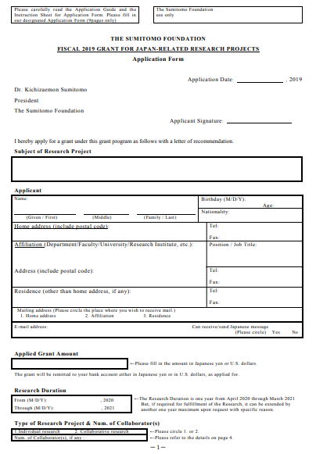
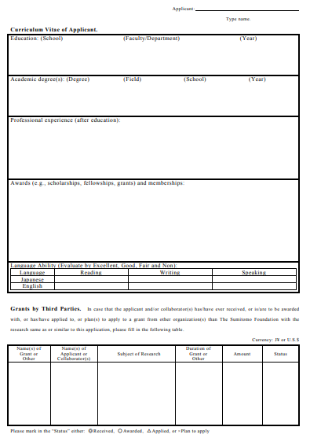
Application Form
Link to download the application form
http://www.sumitomo.or.jp/pdf/jare/Jare%20Application%202019/Jare%20Application%20Form%202019%20E.pdf

Slide 9
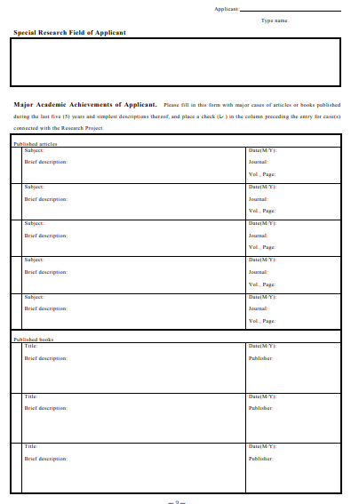
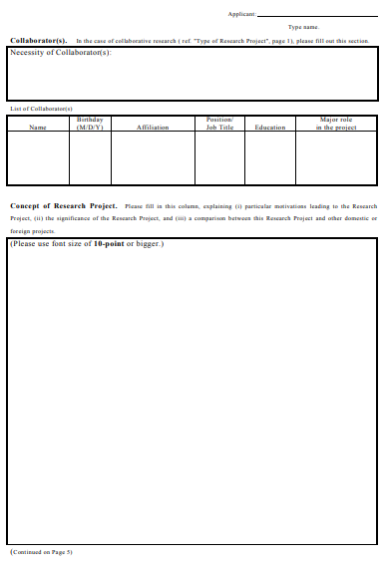
Application Form

Slide 10
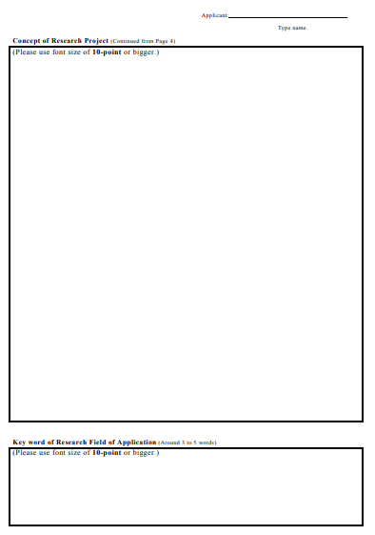
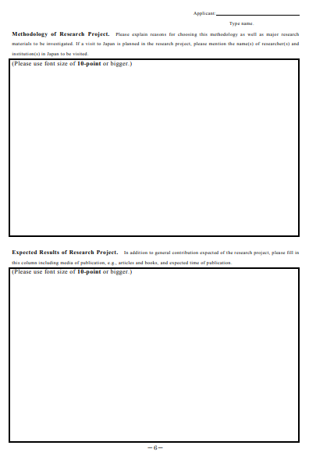
Application Form

Slide 11
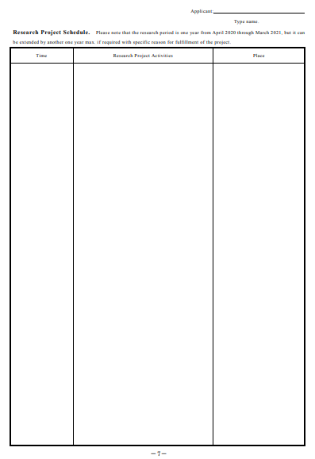
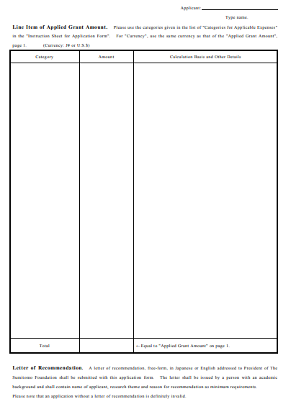
Application Form

Slide 12
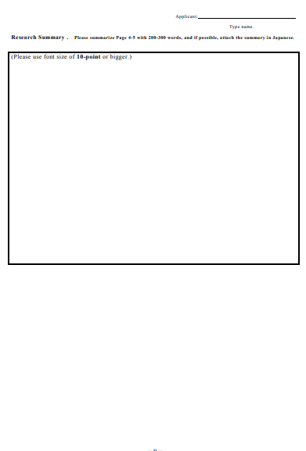
Application Form

Slide 13
 | Themes of Research Projects | Researchers
1 | Modeling of Seafood Production and Marketing Systems of Bangladesh by Supporting Japanese Experiences for Ensuring Food Security and Enhancing Blue Economy in Bangladesh | MD Nazrul Islam(+1) Associate Professor Department of Geograrhy and Environment Jahangirnagar University Bangladesh
2 | Identifying the Role of Tourism in the Process of Natural Disaster Recovery : Comparison between Earthquake Recovery in Kumamoto Prefecture and Hokkaido Prefecture | Chung Shing Chan(+1) Research Assistant Professor Department of Geography and Resource Management The Chinese University of Hong Kong China
3 | Networks of Faith and Profit: Buddhist Traders Between Japan and China, 838-1403 | Yiwen Li Assistant Professor Department of Chinese and History City University of Hong Kong China
4 | A Study on Logistic Collaboration among China, Japan and Korean | Hongmei Li Associate Professor Institute of World Economics Northeast Asian Studies College Jilin University China
5 | On Japanese Speakers' "Requirement Cancelling Speeches and Corresponding Replies" and "Requiring Speeches and Corresponding Replies" | Yang Sun Associate Professorship Department of Japanese Languages College of International Studies Yangzhou University China
6 | The Study of Civil Actions in Manchukoku | Juan Tan Lecturer Institute of Modern Chinese History Central China Normal University China
7 | The impact of innovative mercantilism on Japan's High-speed rail development | Yin-nor Tjia Assistant Professor Department of Asian and International Studies City University of Hong Kong China
8 | Review of the Characteristics of Accepting and Developing on Confucianism between Japan and China, based on Comparative Analysis of Image and so on about the Seventh String qin(important Cultural Properties Grade) of Japan and China | Feng Wang(+5) Professor Chinese Studies Peking University China
9 | The Speech Act in Chinese and Japanese from Multi-linguistic and Multi-cultural Aspect - With "Account" and "Apologies" as Examples | Zhonlian Wen Professor Japanese Department Foreign Language Institute Shanghai University of Electric Power China
10 | The Consumption of the Stories on Japanese Samurai and the Chinese View of Japan | Mei Zhang Assistant Professor Institute of Japanese Studies Chinese Academy of Social Sciences China
11 | Family Education Strategies and Social Network in Skilled Migrants from China in Japan: Mixed Methods Research | Weiguo Zhao Associate Professor School of Psychology Shangdon Normal University China
12 | A Study on the Acceptance and Transliaation of Modern Japanese Literature in China | Yujiao Zhao Lectrure School of Foreign Languages Tianjin University of Commerce China
13 | Study of Human-Thing Relationship in the Inheritance of Japanese Craftsmanship | Feifei Zhou Associate Professor College of Foreign Languages Nanjing University of Aeronautics and Astronautics China
14 | Japan and Malaysia : Exploring Collaboration in Defence Manufacturing Capabilities | Chinnasamy Agamudainambi Malarvizhi(+2) Senior Lecturer Faculty of Management Multimedia University, Malaysia India
15 | Nuclear and Japanese Literature: A Comparative Study on Nuclear Controversy within Japanese Literary Works Published Before and Post Fukushima Nuclear Accident 2011 | Mohammad Gandhi Amannullah Permanent Lecturer and Researcher Department of Japanese Studies Faculty of Humanities Universitas Airlangga Indonesia
16 | A Study on Diversifying Japanese Trading Commodities in the Netherlands East Indies (1868-1942) | Meta Sekar Puji Astuti(+1) Researcher / Lecturer Japanese Literature Department Faculty of Humanities Hasanuddin University Indonesia
17 | A Study of Japanese and Indonesian Backchannel Behavior (contrastive analysis on listener role in interaction) | Lisda Nurjaleka Lecturer Japanese Language Education Department Faculty of Language and Art Universitas Negeri Semarang Indonesia
18 | Decision Making Process in Public Policy: An Analysis of the impact of Jakarta-Bandung Highspeed Railway Project on Japan-Indonesia Bilateral Relations | Pasha Julian Aldrin Head Department of Political Science Faculty of Political and Social Sciences University of Indonesia Indonesia
19 | The Habitus, CapitaLand Field of Indonesian Kenshusei & Jisshusei in Japan | Roberto Masami Prabowo(+2) Form Member Structure Faculty of Humanity-Japanese Language Bina Nusantara University Indonesia
20 | The Community Based Development of Rice Straw Craft in Japan: Experiences and Development Pattern Learned for Rice Farming Community in Indonesia (study case Klaten Regency) | Pandu Purwandaru(+1) Lecturer Universitas Pembangunan Jaya Indonesia
21 | Between Visual and Verbal Receptions: Interpreting and Promoting Ainu Folktales and Culture among Students of West Java and Bali Provinces, Indonesia | Ida Ayu Laksmita Sari(+1) Junior Lecturer Japanese Department Faculty of Arts Udayana University Indonesia
22 | Examining Identity and Belonging of Youth Descendants of Japanese-Indonesian International Marriages Living in Japan and Indonesia: A Comparison | Nino Viartasiwi Senior Research Fellow Resilience Development Initiative Indonesia
23 | In Searching of Modernity: Articles on Japan in the Chinese Indonesian Media in 1945-1955 | Yerry Wirawan Lecturer History Department Faculty of Literature Universitas Sanata Dharma Indonesia
24 | Becoming Korean: A Postcolonial History of Japanese Wives in the Chōsen Sōren Community | KumHee Cho Affiliated Scholar History Department, University of Hong Kong Korea
25 | The Study in Cultural Aspects of the Tokugawa Shogunate's Diplomatic Policy Towards Joseon dynasty through the Analysis of the Theme of Gold-Leafed Folding Screen Presented by the Tokugawa shogunate in 1711 | Jung Miyeon Curator National Museum of Korea Korea
26 | A Study on the Japanese Residents at Jeju in Colonial Period | Ko Young Ja(+1) Principal Researcher Jeju Narrative & Documentary Institute Korea
27 | The Ryukyu envoy and the East Asian Exchange Network in the Early modern era | Lee Hoyun Assistant Professor Department of Liberal Arts Seoul Christian University Korea
28 | A Comparative Study of South Korean and Chinese Processes with Japan | Park Kyung-Min Part Time Lecturer Department of Japanese Studies Global College of Humanities and Area Studies Kookmin University Korea
29 | Interchange for Coexistence in East Asia-focusing on the sea route in Okinawa and Kyushu- | Song Whanbhum(+2) Professor Global Institute for Japanese Studies Korea University Korea
30 | The Movement for East Asian Book Recommendation and Educating the Common People | Sung Hae Jun Professor Tongmyong University Korea
31 | Malaysia's Japan Policy in the context of a rising China : A Re-Interpretation of 'The Look East Policy' | Geetha Govindasamy(+1) Senior Lecturer Department of East Asian Studies Faculty of Arts and Social Science University of Malaya Malaysia
32 | A Comparative Study between Japan and Malaysia : Attitude and Willingness to Donate Organs | Jo Ann Ho(+2) Associate Professor Department of Management and Marketing Faculty of Economics and Management Universiti Putra Malaysia Malaysia
33 | The Study of Relationship Between Japanese-Malay Archipelago based on Motifs of Bronze Bell and (Dotaku Bell) | Adnan Bin Jusoh Lecturer Department of History Faculty of Human Sciences Universiti Pendidikan Sultan Idris Malaysia
34 | Butoh Shakespeare in Southeast Asia | Su Mei Kok(+1) Senior Lecturer Department of English Faculty of Arts and Social Sciences University of Malaya Malaysia
35 | Comparison of the Level of awareness towards river protection and rehabilitation between Malaysian and Japanese by means of contingent valuation method | How Tion Puay(+1) Senior Lecturer River Engineering and Urban Drainage Research Centre Universiti Sains Malaysia Malaysia
36 | Cross-cultural adjustment of Japanese expatriates in Malaysia | Christopher Richardson Senior Lecturer Graduate School of Business Universiti Sains Malaysia Malaysia
37 | A study on the Strawberry-based Product, Packaging and Storage Technologies in Japan Food Industries | Rosnah Shamsudin(+2) Associate Professor Department of Process and Food Engineering Faculty of Engineering Universiti Putra Malaysia Malaysia
38 | The Impact of Artificial Intelligence on the Right to Privacy : A Comparative Study of Data Protection Law in Japan and Malaysia | Pek San Tay(+1) Associate Professor Faculty of Law University of Malaya Malaysia
39 | Japan's EV Charging Station at Management Setup : How can It be Implemented in Malaysia? | Jabbar Al-Fattah Yahaya(+2) Lecturer Faculty of Electrical and Electronic Engineering (FKEE) Universiti Tun Hussein Onn Malaysia Malaysia
40 | A Study of Communication between Malaysia Japanese Speaking Employees and Japanese Expatriates Employers | Lee Su Yeoh(+2) Lecturer School of Languages, Literacies and Translation Universiti Sains Malaysia Malaysia
41 | Employment experiences of Japanese and Malaysian mothers caring for special needs children | Azzarina Zakaria(+2) Senior Lecturer Faculty of Business and Management Universiti Teknologi MARA Malaysia
42 | Memories of Japan: A Study of the Museums and Monuments of Mongolia | Gonchigdorji Nyamdorj Researcher Mongolian Military Museum Mongolia
43 | The stories They Tell, 1941-1975 : Remembering and Interpreting War in Contemporary Popular Stories for Children in Japan and Southeast Asia (Philippines, Vietnam, and Cambodia) | Gonzalo Ⅱ Abreu Campoamor Director/Associate Professor Research Dissemination and Utilization Office, Office of the Vice-Chancellor for Research and Dev't., University of the Philippines Philippines
44 | Re-thinking Journalism Pedagogy in Japan and ASEAN in the Digital-Global Age | Pauline Gidget Resterio Estella(+1) Doctoral candidate and research assistant Institute for Media and Communication Science (iFMK) Technische Universität Ilmenau (Ilmenau University of Technology) Germany Philippines
45 | Migrants' entry into Tokyo's Ecclesial space : The Archdiocese of Tokyo's Vision of a Multicultural Church | Willard Enrique Racelis Macaraan Associate Professor Theology and religious Education Department (TRED) De La Salle University Philippines
46 | Comparative study on the Development of TV White Space Management Practices (COST-Wise-MAP) in Japan, the Philippines, and Singapore | Lawrence Yasay Materum(+1) Associate Professor ECE Department, De La Salle University Philippines
47 | Forms of social support for Filipino Workers in Japan : Implications to Migrant Labor Policy and Practices | Veronica Esposo Ramirez(+1) Associate Professor Center for Research and Communication University of Asia and the Pacific Philippines
48 | Research on Fake News and Lessons from Japan for Southeast Asia | James Gomez Chairperson, Board of Director Asia Centre, Thailand Singapore
49 | Art the Seto Inland Sea: Examining the Impact of the Setouchi Triennale on Local Communities | Michelle Yin Yin Lim Assistant Professor School of Art, Design and Media Nanyang Technological University Singapore
50 | LGBT activism, rights and visibility in global Japan: the case of Tokyo Rainbow Pride and Okinawa Pink Dot | Shu Min Yuen Senior Tutor Department of Japanese Studies National University of Singapore Singapore
51 | Designing Asia: An investigation into "Zokei" activities in interwar Japan and Colonial Taiwan | I-Fan Chen Ph. D. Candidate Department of Visual Arts University of California, San Diego, USA Taiwan
52 | A Study of the Tasuku Yamanaka Manufacture's Development and the Effects of the Taiwan Lacquer-ware | I-Hsin Fan Associate Professor Department of Cultural Tourism National United University Taiwan
53 | Technology and Taste: The Making of Dried Skipjack Tuna Products and the Evolution of Taste in Modern Taiwan | Chung hao Kuo(+1) Assistant Professor and Research Fellow Center for General Education Taipei Medical University Taiwan
54 | Minoru Togo and the Building of Taiwan Agriculture Investigation System in Modern Taiwan | Pei-Hsin Lin Part-time Assistant Professor Department of History National Taipei University Taiwan
55 | The Intercultural Communication Problems Observed by the Workers and the Japanese Companies in Taiwan | Hua Wu Associate Professor Department of Applied Japanese Taiwan National Kaohsiung University of Hospitality and Tourism Taiwan
56 | Feasibility of a Culturally Sensitive Communications Strategy to Engage Key Populations in HIV Prevention Awareness and improve Health Access in Japan : Comparisons between Japan, Indonesia and Thailand | Chattiya Nitpolprasert(+1) Social and Behavioral Researcher Adam's Love Global Foundation for MSM and Transgender Health (ALGO) Thailand
57 | Nurturing High-value Personnel in te Age of Glovalization: Issues and Prospects for Improvement of a Curriculum-based Overseas Internship Program | Siriwon Munintarawong Full-time Lecture Department of Japanese Faculty of Liberal Arts Thammsat University Thailand
58 | The Conservation of Historic Town and Disaster Risk Reduction : Lessons Learned from the Japanese 'Denkenchiku' System to Improve Disaster Preparedness by Local Communities in Thailand | Nattasit Srinurak Head of UDE center, Resarcher Urban design and environmental studies center/Social Research Institute, Chiang Mai University Thailand
59 | Disaster Education and Community Development : A Case Study of Japan and Thailand | Waricha Wongphyat Assistant Professor Department of Architecture, Faculty of Architecture Chulalongkorn University Thailand
60 | Organizational culture and employee's loyalty: The analysis of Japanese enterprises and Vietnamese enterprises applying Japanese corporate culture. | Lan Thi Ngoc Le(+3) Deputy Head, Researcher Department of Research and Academic Affairs Foreign Trade University Viet Nam
61 | Studying on Current Strikes in Japanese Companies in Vietnam, Compared with Taiwanese and Korean Companies. | Dung Duy Nguyen(+3) Former Director of ISEAS Senior Researcher The Institute for Southeast Asian Studies (ISEAS) Vietnam Academy of Social Sciences Viet Nam
62 | Out-Migration, Depopulation and Revitalization of Rural Communities: Japanese Experiences and Lessons for Vietnam | Pham Tien Thanh(+2) Lecturer Department of Economics Faculty of Business administration Ton Duc Thang University Viet Nam
Successful Application
 | Themes of Research Projects | Country
1 | Modeling of Seafood Production and Marketing Systems of Bangladesh by Supporting Japanese Experiences for Ensuring Food Security and Enhancing Blue Economy in Bangladesh | Bangladesh
2 | Identifying the Role of Tourism in the Process of Natural Disaster Recovery : Comparison between Earthquake Recovery in Kumamoto Prefecture and Hokkaido Prefecture | China
3 | Networks of Faith and Profit: Buddhist Traders Between Japan and China, 838-1403 | China
4 | A Study on Logistic Collaboration among China, Japan and Korean | China
5 | On Japanese Speakers' "Requirement Cancelling Speeches and Corresponding Replies" and "Requiring Speeches and Corresponding Replies" | China
6 | The Study of Civil Actions in Manchukoku | China
7 | The impact of innovative mercantilism on Japan's High-speed rail development | China
8 | Review of the Characteristics of Accepting and Developing on Confucianism between Japan and China, based on Comparative Analysis of Image and so on about the Seventh String qin(important Cultural Properties Grade) of Japan and China | China
9 | The Speech Act in Chinese and Japanese from Multi-linguistic and Multi-cultural Aspect - With "Account" and "Apologies" as Examples | China
10 | The Consumption of the Stories on Japanese Samurai and the Chinese View of Japan | China

Slide 14
 | Themes of Research Projects | Researchers
1 | Modeling of Seafood Production and Marketing Systems of Bangladesh by Supporting Japanese Experiences for Ensuring Food Security and Enhancing Blue Economy in Bangladesh | MD Nazrul Islam(+1) Associate Professor Department of Geograrhy and Environment Jahangirnagar University Bangladesh
2 | Identifying the Role of Tourism in the Process of Natural Disaster Recovery : Comparison between Earthquake Recovery in Kumamoto Prefecture and Hokkaido Prefecture | Chung Shing Chan(+1) Research Assistant Professor Department of Geography and Resource Management The Chinese University of Hong Kong China
3 | Networks of Faith and Profit: Buddhist Traders Between Japan and China, 838-1403 | Yiwen Li Assistant Professor Department of Chinese and History City University of Hong Kong China
4 | A Study on Logistic Collaboration among China, Japan and Korean | Hongmei Li Associate Professor Institute of World Economics Northeast Asian Studies College Jilin University China
5 | On Japanese Speakers' "Requirement Cancelling Speeches and Corresponding Replies" and "Requiring Speeches and Corresponding Replies" | Yang Sun Associate Professorship Department of Japanese Languages College of International Studies Yangzhou University China
6 | The Study of Civil Actions in Manchukoku | Juan Tan Lecturer Institute of Modern Chinese History Central China Normal University China
7 | The impact of innovative mercantilism on Japan's High-speed rail development | Yin-nor Tjia Assistant Professor Department of Asian and International Studies City University of Hong Kong China
8 | Review of the Characteristics of Accepting and Developing on Confucianism between Japan and China, based on Comparative Analysis of Image and so on about the Seventh String qin(important Cultural Properties Grade) of Japan and China | Feng Wang(+5) Professor Chinese Studies Peking University China
9 | The Speech Act in Chinese and Japanese from Multi-linguistic and Multi-cultural Aspect - With "Account" and "Apologies" as Examples | Zhonlian Wen Professor Japanese Department Foreign Language Institute Shanghai University of Electric Power China
10 | The Consumption of the Stories on Japanese Samurai and the Chinese View of Japan | Mei Zhang Assistant Professor Institute of Japanese Studies Chinese Academy of Social Sciences China
11 | Family Education Strategies and Social Network in Skilled Migrants from China in Japan: Mixed Methods Research | Weiguo Zhao Associate Professor School of Psychology Shangdon Normal University China
12 | A Study on the Acceptance and Transliaation of Modern Japanese Literature in China | Yujiao Zhao Lectrure School of Foreign Languages Tianjin University of Commerce China
13 | Study of Human-Thing Relationship in the Inheritance of Japanese Craftsmanship | Feifei Zhou Associate Professor College of Foreign Languages Nanjing University of Aeronautics and Astronautics China
14 | Japan and Malaysia : Exploring Collaboration in Defence Manufacturing Capabilities | Chinnasamy Agamudainambi Malarvizhi(+2) Senior Lecturer Faculty of Management Multimedia University, Malaysia India
15 | Nuclear and Japanese Literature: A Comparative Study on Nuclear Controversy within Japanese Literary Works Published Before and Post Fukushima Nuclear Accident 2011 | Mohammad Gandhi Amannullah Permanent Lecturer and Researcher Department of Japanese Studies Faculty of Humanities Universitas Airlangga Indonesia
16 | A Study on Diversifying Japanese Trading Commodities in the Netherlands East Indies (1868-1942) | Meta Sekar Puji Astuti(+1) Researcher / Lecturer Japanese Literature Department Faculty of Humanities Hasanuddin University Indonesia
17 | A Study of Japanese and Indonesian Backchannel Behavior (contrastive analysis on listener role in interaction) | Lisda Nurjaleka Lecturer Japanese Language Education Department Faculty of Language and Art Universitas Negeri Semarang Indonesia
18 | Decision Making Process in Public Policy: An Analysis of the impact of Jakarta-Bandung Highspeed Railway Project on Japan-Indonesia Bilateral Relations | Pasha Julian Aldrin Head Department of Political Science Faculty of Political and Social Sciences University of Indonesia Indonesia
19 | The Habitus, CapitaLand Field of Indonesian Kenshusei & Jisshusei in Japan | Roberto Masami Prabowo(+2) Form Member Structure Faculty of Humanity-Japanese Language Bina Nusantara University Indonesia
20 | The Community Based Development of Rice Straw Craft in Japan: Experiences and Development Pattern Learned for Rice Farming Community in Indonesia (study case Klaten Regency) | Pandu Purwandaru(+1) Lecturer Universitas Pembangunan Jaya Indonesia
21 | Between Visual and Verbal Receptions: Interpreting and Promoting Ainu Folktales and Culture among Students of West Java and Bali Provinces, Indonesia | Ida Ayu Laksmita Sari(+1) Junior Lecturer Japanese Department Faculty of Arts Udayana University Indonesia
22 | Examining Identity and Belonging of Youth Descendants of Japanese-Indonesian International Marriages Living in Japan and Indonesia: A Comparison | Nino Viartasiwi Senior Research Fellow Resilience Development Initiative Indonesia
23 | In Searching of Modernity: Articles on Japan in the Chinese Indonesian Media in 1945-1955 | Yerry Wirawan Lecturer History Department Faculty of Literature Universitas Sanata Dharma Indonesia
24 | Becoming Korean: A Postcolonial History of Japanese Wives in the Chōsen Sōren Community | KumHee Cho Affiliated Scholar History Department, University of Hong Kong Korea
25 | The Study in Cultural Aspects of the Tokugawa Shogunate's Diplomatic Policy Towards Joseon dynasty through the Analysis of the Theme of Gold-Leafed Folding Screen Presented by the Tokugawa shogunate in 1711 | Jung Miyeon Curator National Museum of Korea Korea
26 | A Study on the Japanese Residents at Jeju in Colonial Period | Ko Young Ja(+1) Principal Researcher Jeju Narrative & Documentary Institute Korea
27 | The Ryukyu envoy and the East Asian Exchange Network in the Early modern era | Lee Hoyun Assistant Professor Department of Liberal Arts Seoul Christian University Korea
28 | A Comparative Study of South Korean and Chinese Processes with Japan | Park Kyung-Min Part Time Lecturer Department of Japanese Studies Global College of Humanities and Area Studies Kookmin University Korea
29 | Interchange for Coexistence in East Asia-focusing on the sea route in Okinawa and Kyushu- | Song Whanbhum(+2) Professor Global Institute for Japanese Studies Korea University Korea
30 | The Movement for East Asian Book Recommendation and Educating the Common People | Sung Hae Jun Professor Tongmyong University Korea
31 | Malaysia's Japan Policy in the context of a rising China : A Re-Interpretation of 'The Look East Policy' | Geetha Govindasamy(+1) Senior Lecturer Department of East Asian Studies Faculty of Arts and Social Science University of Malaya Malaysia
32 | A Comparative Study between Japan and Malaysia : Attitude and Willingness to Donate Organs | Jo Ann Ho(+2) Associate Professor Department of Management and Marketing Faculty of Economics and Management Universiti Putra Malaysia Malaysia
33 | The Study of Relationship Between Japanese-Malay Archipelago based on Motifs of Bronze Bell and (Dotaku Bell) | Adnan Bin Jusoh Lecturer Department of History Faculty of Human Sciences Universiti Pendidikan Sultan Idris Malaysia
34 | Butoh Shakespeare in Southeast Asia | Su Mei Kok(+1) Senior Lecturer Department of English Faculty of Arts and Social Sciences University of Malaya Malaysia
35 | Comparison of the Level of awareness towards river protection and rehabilitation between Malaysian and Japanese by means of contingent valuation method | How Tion Puay(+1) Senior Lecturer River Engineering and Urban Drainage Research Centre Universiti Sains Malaysia Malaysia
36 | Cross-cultural adjustment of Japanese expatriates in Malaysia | Christopher Richardson Senior Lecturer Graduate School of Business Universiti Sains Malaysia Malaysia
37 | A study on the Strawberry-based Product, Packaging and Storage Technologies in Japan Food Industries | Rosnah Shamsudin(+2) Associate Professor Department of Process and Food Engineering Faculty of Engineering Universiti Putra Malaysia Malaysia
38 | The Impact of Artificial Intelligence on the Right to Privacy : A Comparative Study of Data Protection Law in Japan and Malaysia | Pek San Tay(+1) Associate Professor Faculty of Law University of Malaya Malaysia
39 | Japan's EV Charging Station at Management Setup : How can It be Implemented in Malaysia? | Jabbar Al-Fattah Yahaya(+2) Lecturer Faculty of Electrical and Electronic Engineering (FKEE) Universiti Tun Hussein Onn Malaysia Malaysia
40 | A Study of Communication between Malaysia Japanese Speaking Employees and Japanese Expatriates Employers | Lee Su Yeoh(+2) Lecturer School of Languages, Literacies and Translation Universiti Sains Malaysia Malaysia
41 | Employment experiences of Japanese and Malaysian mothers caring for special needs children | Azzarina Zakaria(+2) Senior Lecturer Faculty of Business and Management Universiti Teknologi MARA Malaysia
42 | Memories of Japan: A Study of the Museums and Monuments of Mongolia | Gonchigdorji Nyamdorj Researcher Mongolian Military Museum Mongolia
43 | The stories They Tell, 1941-1975 : Remembering and Interpreting War in Contemporary Popular Stories for Children in Japan and Southeast Asia (Philippines, Vietnam, and Cambodia) | Gonzalo Ⅱ Abreu Campoamor Director/Associate Professor Research Dissemination and Utilization Office, Office of the Vice-Chancellor for Research and Dev't., University of the Philippines Philippines
44 | Re-thinking Journalism Pedagogy in Japan and ASEAN in the Digital-Global Age | Pauline Gidget Resterio Estella(+1) Doctoral candidate and research assistant Institute for Media and Communication Science (iFMK) Technische Universität Ilmenau (Ilmenau University of Technology) Germany Philippines
45 | Migrants' entry into Tokyo's Ecclesial space : The Archdiocese of Tokyo's Vision of a Multicultural Church | Willard Enrique Racelis Macaraan Associate Professor Theology and religious Education Department (TRED) De La Salle University Philippines
46 | Comparative study on the Development of TV White Space Management Practices (COST-Wise-MAP) in Japan, the Philippines, and Singapore | Lawrence Yasay Materum(+1) Associate Professor ECE Department, De La Salle University Philippines
47 | Forms of social support for Filipino Workers in Japan : Implications to Migrant Labor Policy and Practices | Veronica Esposo Ramirez(+1) Associate Professor Center for Research and Communication University of Asia and the Pacific Philippines
48 | Research on Fake News and Lessons from Japan for Southeast Asia | James Gomez Chairperson, Board of Director Asia Centre, Thailand Singapore
49 | Art the Seto Inland Sea: Examining the Impact of the Setouchi Triennale on Local Communities | Michelle Yin Yin Lim Assistant Professor School of Art, Design and Media Nanyang Technological University Singapore
50 | LGBT activism, rights and visibility in global Japan: the case of Tokyo Rainbow Pride and Okinawa Pink Dot | Shu Min Yuen Senior Tutor Department of Japanese Studies National University of Singapore Singapore
51 | Designing Asia: An investigation into "Zokei" activities in interwar Japan and Colonial Taiwan | I-Fan Chen Ph. D. Candidate Department of Visual Arts University of California, San Diego, USA Taiwan
52 | A Study of the Tasuku Yamanaka Manufacture's Development and the Effects of the Taiwan Lacquer-ware | I-Hsin Fan Associate Professor Department of Cultural Tourism National United University Taiwan
53 | Technology and Taste: The Making of Dried Skipjack Tuna Products and the Evolution of Taste in Modern Taiwan | Chung hao Kuo(+1) Assistant Professor and Research Fellow Center for General Education Taipei Medical University Taiwan
54 | Minoru Togo and the Building of Taiwan Agriculture Investigation System in Modern Taiwan | Pei-Hsin Lin Part-time Assistant Professor Department of History National Taipei University Taiwan
55 | The Intercultural Communication Problems Observed by the Workers and the Japanese Companies in Taiwan | Hua Wu Associate Professor Department of Applied Japanese Taiwan National Kaohsiung University of Hospitality and Tourism Taiwan
56 | Feasibility of a Culturally Sensitive Communications Strategy to Engage Key Populations in HIV Prevention Awareness and improve Health Access in Japan : Comparisons between Japan, Indonesia and Thailand | Chattiya Nitpolprasert(+1) Social and Behavioral Researcher Adam's Love Global Foundation for MSM and Transgender Health (ALGO) Thailand
57 | Nurturing High-value Personnel in te Age of Glovalization: Issues and Prospects for Improvement of a Curriculum-based Overseas Internship Program | Siriwon Munintarawong Full-time Lecture Department of Japanese Faculty of Liberal Arts Thammsat University Thailand
58 | The Conservation of Historic Town and Disaster Risk Reduction : Lessons Learned from the Japanese 'Denkenchiku' System to Improve Disaster Preparedness by Local Communities in Thailand | Nattasit Srinurak Head of UDE center, Resarcher Urban design and environmental studies center/Social Research Institute, Chiang Mai University Thailand
59 | Disaster Education and Community Development : A Case Study of Japan and Thailand | Waricha Wongphyat Assistant Professor Department of Architecture, Faculty of Architecture Chulalongkorn University Thailand
60 | Organizational culture and employee's loyalty: The analysis of Japanese enterprises and Vietnamese enterprises applying Japanese corporate culture. | Lan Thi Ngoc Le(+3) Deputy Head, Researcher Department of Research and Academic Affairs Foreign Trade University Viet Nam
61 | Studying on Current Strikes in Japanese Companies in Vietnam, Compared with Taiwanese and Korean Companies. | Dung Duy Nguyen(+3) Former Director of ISEAS Senior Researcher The Institute for Southeast Asian Studies (ISEAS) Vietnam Academy of Social Sciences Viet Nam
62 | Out-Migration, Depopulation and Revitalization of Rural Communities: Japanese Experiences and Lessons for Vietnam | Pham Tien Thanh(+2) Lecturer Department of Economics Faculty of Business administration Ton Duc Thang University Viet Nam
Successful Application
 | Themes of Research Projects | Country
11 | Family Education Strategies and Social Network in Skilled Migrants from China in Japan: Mixed Methods Research | China
12 | A Study on the Acceptance and Transliaation of Modern Japanese Literature in China | China
13 | Study of Human-Thing Relationship in the Inheritance of Japanese Craftsmanship | China
14 | Japan and Malaysia : Exploring Collaboration in Defence Manufacturing Capabilities | India
15 | Nuclear and Japanese Literature: A Comparative Study on Nuclear Controversy within Japanese Literary Works Published Before and Post Fukushima Nuclear Accident 2011 | Indonesia
16 | A Study on Diversifying Japanese Trading Commodities in the Netherlands East Indies (1868-1942) | Indonesia
17 | A Study of Japanese and Indonesian Backchannel Behavior (contrastive analysis on listener role in interaction) | Indonesia
18 | Decision Making Process in Public Policy: An Analysis of the impact of Jakarta-Bandung Highspeed Railway Project on Japan-Indonesia Bilateral Relations | Indonesia
19 | The Habitus, CapitaLand Field of Indonesian Kenshusei & Jisshusei in Japan | Indonesia
20 | The Community Based Development of Rice Straw Craft in Japan: Experiences and Development Pattern Learned for Rice Farming Community in Indonesia (study case Klaten Regency) | Indonesia

Slide 15
 | Themes of Research Projects | Researchers
1 | Modeling of Seafood Production and Marketing Systems of Bangladesh by Supporting Japanese Experiences for Ensuring Food Security and Enhancing Blue Economy in Bangladesh | MD Nazrul Islam(+1) Associate Professor Department of Geograrhy and Environment Jahangirnagar University Bangladesh
2 | Identifying the Role of Tourism in the Process of Natural Disaster Recovery : Comparison between Earthquake Recovery in Kumamoto Prefecture and Hokkaido Prefecture | Chung Shing Chan(+1) Research Assistant Professor Department of Geography and Resource Management The Chinese University of Hong Kong China
3 | Networks of Faith and Profit: Buddhist Traders Between Japan and China, 838-1403 | Yiwen Li Assistant Professor Department of Chinese and History City University of Hong Kong China
4 | A Study on Logistic Collaboration among China, Japan and Korean | Hongmei Li Associate Professor Institute of World Economics Northeast Asian Studies College Jilin University China
5 | On Japanese Speakers' "Requirement Cancelling Speeches and Corresponding Replies" and "Requiring Speeches and Corresponding Replies" | Yang Sun Associate Professorship Department of Japanese Languages College of International Studies Yangzhou University China
6 | The Study of Civil Actions in Manchukoku | Juan Tan Lecturer Institute of Modern Chinese History Central China Normal University China
7 | The impact of innovative mercantilism on Japan's High-speed rail development | Yin-nor Tjia Assistant Professor Department of Asian and International Studies City University of Hong Kong China
8 | Review of the Characteristics of Accepting and Developing on Confucianism between Japan and China, based on Comparative Analysis of Image and so on about the Seventh String qin(important Cultural Properties Grade) of Japan and China | Feng Wang(+5) Professor Chinese Studies Peking University China
9 | The Speech Act in Chinese and Japanese from Multi-linguistic and Multi-cultural Aspect - With "Account" and "Apologies" as Examples | Zhonlian Wen Professor Japanese Department Foreign Language Institute Shanghai University of Electric Power China
10 | The Consumption of the Stories on Japanese Samurai and the Chinese View of Japan | Mei Zhang Assistant Professor Institute of Japanese Studies Chinese Academy of Social Sciences China
11 | Family Education Strategies and Social Network in Skilled Migrants from China in Japan: Mixed Methods Research | Weiguo Zhao Associate Professor School of Psychology Shangdon Normal University China
12 | A Study on the Acceptance and Transliaation of Modern Japanese Literature in China | Yujiao Zhao Lectrure School of Foreign Languages Tianjin University of Commerce China
13 | Study of Human-Thing Relationship in the Inheritance of Japanese Craftsmanship | Feifei Zhou Associate Professor College of Foreign Languages Nanjing University of Aeronautics and Astronautics China
14 | Japan and Malaysia : Exploring Collaboration in Defence Manufacturing Capabilities | Chinnasamy Agamudainambi Malarvizhi(+2) Senior Lecturer Faculty of Management Multimedia University, Malaysia India
15 | Nuclear and Japanese Literature: A Comparative Study on Nuclear Controversy within Japanese Literary Works Published Before and Post Fukushima Nuclear Accident 2011 | Mohammad Gandhi Amannullah Permanent Lecturer and Researcher Department of Japanese Studies Faculty of Humanities Universitas Airlangga Indonesia
16 | A Study on Diversifying Japanese Trading Commodities in the Netherlands East Indies (1868-1942) | Meta Sekar Puji Astuti(+1) Researcher / Lecturer Japanese Literature Department Faculty of Humanities Hasanuddin University Indonesia
17 | A Study of Japanese and Indonesian Backchannel Behavior (contrastive analysis on listener role in interaction) | Lisda Nurjaleka Lecturer Japanese Language Education Department Faculty of Language and Art Universitas Negeri Semarang Indonesia
18 | Decision Making Process in Public Policy: An Analysis of the impact of Jakarta-Bandung Highspeed Railway Project on Japan-Indonesia Bilateral Relations | Pasha Julian Aldrin Head Department of Political Science Faculty of Political and Social Sciences University of Indonesia Indonesia
19 | The Habitus, CapitaLand Field of Indonesian Kenshusei & Jisshusei in Japan | Roberto Masami Prabowo(+2) Form Member Structure Faculty of Humanity-Japanese Language Bina Nusantara University Indonesia
20 | The Community Based Development of Rice Straw Craft in Japan: Experiences and Development Pattern Learned for Rice Farming Community in Indonesia (study case Klaten Regency) | Pandu Purwandaru(+1) Lecturer Universitas Pembangunan Jaya Indonesia
21 | Between Visual and Verbal Receptions: Interpreting and Promoting Ainu Folktales and Culture among Students of West Java and Bali Provinces, Indonesia | Ida Ayu Laksmita Sari(+1) Junior Lecturer Japanese Department Faculty of Arts Udayana University Indonesia
22 | Examining Identity and Belonging of Youth Descendants of Japanese-Indonesian International Marriages Living in Japan and Indonesia: A Comparison | Nino Viartasiwi Senior Research Fellow Resilience Development Initiative Indonesia
23 | In Searching of Modernity: Articles on Japan in the Chinese Indonesian Media in 1945-1955 | Yerry Wirawan Lecturer History Department Faculty of Literature Universitas Sanata Dharma Indonesia
24 | Becoming Korean: A Postcolonial History of Japanese Wives in the Chōsen Sōren Community | KumHee Cho Affiliated Scholar History Department, University of Hong Kong Korea
25 | The Study in Cultural Aspects of the Tokugawa Shogunate's Diplomatic Policy Towards Joseon dynasty through the Analysis of the Theme of Gold-Leafed Folding Screen Presented by the Tokugawa shogunate in 1711 | Jung Miyeon Curator National Museum of Korea Korea
26 | A Study on the Japanese Residents at Jeju in Colonial Period | Ko Young Ja(+1) Principal Researcher Jeju Narrative & Documentary Institute Korea
27 | The Ryukyu envoy and the East Asian Exchange Network in the Early modern era | Lee Hoyun Assistant Professor Department of Liberal Arts Seoul Christian University Korea
28 | A Comparative Study of South Korean and Chinese Processes with Japan | Park Kyung-Min Part Time Lecturer Department of Japanese Studies Global College of Humanities and Area Studies Kookmin University Korea
29 | Interchange for Coexistence in East Asia-focusing on the sea route in Okinawa and Kyushu- | Song Whanbhum(+2) Professor Global Institute for Japanese Studies Korea University Korea
30 | The Movement for East Asian Book Recommendation and Educating the Common People | Sung Hae Jun Professor Tongmyong University Korea
31 | Malaysia's Japan Policy in the context of a rising China : A Re-Interpretation of 'The Look East Policy' | Geetha Govindasamy(+1) Senior Lecturer Department of East Asian Studies Faculty of Arts and Social Science University of Malaya Malaysia
32 | A Comparative Study between Japan and Malaysia : Attitude and Willingness to Donate Organs | Jo Ann Ho(+2) Associate Professor Department of Management and Marketing Faculty of Economics and Management Universiti Putra Malaysia Malaysia
33 | The Study of Relationship Between Japanese-Malay Archipelago based on Motifs of Bronze Bell and (Dotaku Bell) | Adnan Bin Jusoh Lecturer Department of History Faculty of Human Sciences Universiti Pendidikan Sultan Idris Malaysia
34 | Butoh Shakespeare in Southeast Asia | Su Mei Kok(+1) Senior Lecturer Department of English Faculty of Arts and Social Sciences University of Malaya Malaysia
35 | Comparison of the Level of awareness towards river protection and rehabilitation between Malaysian and Japanese by means of contingent valuation method | How Tion Puay(+1) Senior Lecturer River Engineering and Urban Drainage Research Centre Universiti Sains Malaysia Malaysia
36 | Cross-cultural adjustment of Japanese expatriates in Malaysia | Christopher Richardson Senior Lecturer Graduate School of Business Universiti Sains Malaysia Malaysia
37 | A study on the Strawberry-based Product, Packaging and Storage Technologies in Japan Food Industries | Rosnah Shamsudin(+2) Associate Professor Department of Process and Food Engineering Faculty of Engineering Universiti Putra Malaysia Malaysia
38 | The Impact of Artificial Intelligence on the Right to Privacy : A Comparative Study of Data Protection Law in Japan and Malaysia | Pek San Tay(+1) Associate Professor Faculty of Law University of Malaya Malaysia
39 | Japan's EV Charging Station at Management Setup : How can It be Implemented in Malaysia? | Jabbar Al-Fattah Yahaya(+2) Lecturer Faculty of Electrical and Electronic Engineering (FKEE) Universiti Tun Hussein Onn Malaysia Malaysia
40 | A Study of Communication between Malaysia Japanese Speaking Employees and Japanese Expatriates Employers | Lee Su Yeoh(+2) Lecturer School of Languages, Literacies and Translation Universiti Sains Malaysia Malaysia
41 | Employment experiences of Japanese and Malaysian mothers caring for special needs children | Azzarina Zakaria(+2) Senior Lecturer Faculty of Business and Management Universiti Teknologi MARA Malaysia
42 | Memories of Japan: A Study of the Museums and Monuments of Mongolia | Gonchigdorji Nyamdorj Researcher Mongolian Military Museum Mongolia
43 | The stories They Tell, 1941-1975 : Remembering and Interpreting War in Contemporary Popular Stories for Children in Japan and Southeast Asia (Philippines, Vietnam, and Cambodia) | Gonzalo Ⅱ Abreu Campoamor Director/Associate Professor Research Dissemination and Utilization Office, Office of the Vice-Chancellor for Research and Dev't., University of the Philippines Philippines
44 | Re-thinking Journalism Pedagogy in Japan and ASEAN in the Digital-Global Age | Pauline Gidget Resterio Estella(+1) Doctoral candidate and research assistant Institute for Media and Communication Science (iFMK) Technische Universität Ilmenau (Ilmenau University of Technology) Germany Philippines
45 | Migrants' entry into Tokyo's Ecclesial space : The Archdiocese of Tokyo's Vision of a Multicultural Church | Willard Enrique Racelis Macaraan Associate Professor Theology and religious Education Department (TRED) De La Salle University Philippines
46 | Comparative study on the Development of TV White Space Management Practices (COST-Wise-MAP) in Japan, the Philippines, and Singapore | Lawrence Yasay Materum(+1) Associate Professor ECE Department, De La Salle University Philippines
47 | Forms of social support for Filipino Workers in Japan : Implications to Migrant Labor Policy and Practices | Veronica Esposo Ramirez(+1) Associate Professor Center for Research and Communication University of Asia and the Pacific Philippines
48 | Research on Fake News and Lessons from Japan for Southeast Asia | James Gomez Chairperson, Board of Director Asia Centre, Thailand Singapore
49 | Art the Seto Inland Sea: Examining the Impact of the Setouchi Triennale on Local Communities | Michelle Yin Yin Lim Assistant Professor School of Art, Design and Media Nanyang Technological University Singapore
50 | LGBT activism, rights and visibility in global Japan: the case of Tokyo Rainbow Pride and Okinawa Pink Dot | Shu Min Yuen Senior Tutor Department of Japanese Studies National University of Singapore Singapore
51 | Designing Asia: An investigation into "Zokei" activities in interwar Japan and Colonial Taiwan | I-Fan Chen Ph. D. Candidate Department of Visual Arts University of California, San Diego, USA Taiwan
52 | A Study of the Tasuku Yamanaka Manufacture's Development and the Effects of the Taiwan Lacquer-ware | I-Hsin Fan Associate Professor Department of Cultural Tourism National United University Taiwan
53 | Technology and Taste: The Making of Dried Skipjack Tuna Products and the Evolution of Taste in Modern Taiwan | Chung hao Kuo(+1) Assistant Professor and Research Fellow Center for General Education Taipei Medical University Taiwan
54 | Minoru Togo and the Building of Taiwan Agriculture Investigation System in Modern Taiwan | Pei-Hsin Lin Part-time Assistant Professor Department of History National Taipei University Taiwan
55 | The Intercultural Communication Problems Observed by the Workers and the Japanese Companies in Taiwan | Hua Wu Associate Professor Department of Applied Japanese Taiwan National Kaohsiung University of Hospitality and Tourism Taiwan
56 | Feasibility of a Culturally Sensitive Communications Strategy to Engage Key Populations in HIV Prevention Awareness and improve Health Access in Japan : Comparisons between Japan, Indonesia and Thailand | Chattiya Nitpolprasert(+1) Social and Behavioral Researcher Adam's Love Global Foundation for MSM and Transgender Health (ALGO) Thailand
57 | Nurturing High-value Personnel in te Age of Glovalization: Issues and Prospects for Improvement of a Curriculum-based Overseas Internship Program | Siriwon Munintarawong Full-time Lecture Department of Japanese Faculty of Liberal Arts Thammsat University Thailand
58 | The Conservation of Historic Town and Disaster Risk Reduction : Lessons Learned from the Japanese 'Denkenchiku' System to Improve Disaster Preparedness by Local Communities in Thailand | Nattasit Srinurak Head of UDE center, Resarcher Urban design and environmental studies center/Social Research Institute, Chiang Mai University Thailand
59 | Disaster Education and Community Development : A Case Study of Japan and Thailand | Waricha Wongphyat Assistant Professor Department of Architecture, Faculty of Architecture Chulalongkorn University Thailand
60 | Organizational culture and employee's loyalty: The analysis of Japanese enterprises and Vietnamese enterprises applying Japanese corporate culture. | Lan Thi Ngoc Le(+3) Deputy Head, Researcher Department of Research and Academic Affairs Foreign Trade University Viet Nam
61 | Studying on Current Strikes in Japanese Companies in Vietnam, Compared with Taiwanese and Korean Companies. | Dung Duy Nguyen(+3) Former Director of ISEAS Senior Researcher The Institute for Southeast Asian Studies (ISEAS) Vietnam Academy of Social Sciences Viet Nam
62 | Out-Migration, Depopulation and Revitalization of Rural Communities: Japanese Experiences and Lessons for Vietnam | Pham Tien Thanh(+2) Lecturer Department of Economics Faculty of Business administration Ton Duc Thang University Viet Nam
Successful Application
 | Themes of Research Projects | Country
21 | Between Visual and Verbal Receptions: Interpreting and Promoting Ainu Folktales and Culture among Students of West Java and Bali Provinces, Indonesia | Indonesia
22 | Examining Identity and Belonging of Youth Descendants of Japanese-Indonesian International Marriages Living in Japan and Indonesia: A Comparison | Indonesia
23 | In Searching of Modernity: Articles on Japan in the Chinese Indonesian Media in 1945-1955 | Indonesia
24 | Becoming Korean: A Postcolonial History of Japanese Wives in the Chōsen Sōren Community | Korea
25 | The Study in Cultural Aspects of the Tokugawa Shogunate's Diplomatic Policy Towards Joseon dynasty through the Analysis of the Theme of Gold-Leafed Folding Screen Presented by the Tokugawa shogunate in 1711 | Korea
26 | A Study on the Japanese Residents at Jeju in Colonial Period | Korea
27 | The Ryukyu envoy and the East Asian Exchange Network in the Early modern era | Korea
28 | A Comparative Study of South Korean and Chinese Processes with Japan | Korea
29 | Interchange for Coexistence in East Asia-focusing on the sea route in Okinawa and Kyushu- | Korea
30 | The Movement for East Asian Book Recommendation and Educating the Common People | Korea

Slide 16
 | Themes of Research Projects | Researchers
1 | Modeling of Seafood Production and Marketing Systems of Bangladesh by Supporting Japanese Experiences for Ensuring Food Security and Enhancing Blue Economy in Bangladesh | MD Nazrul Islam(+1) Associate Professor Department of Geograrhy and Environment Jahangirnagar University Bangladesh
2 | Identifying the Role of Tourism in the Process of Natural Disaster Recovery : Comparison between Earthquake Recovery in Kumamoto Prefecture and Hokkaido Prefecture | Chung Shing Chan(+1) Research Assistant Professor Department of Geography and Resource Management The Chinese University of Hong Kong China
3 | Networks of Faith and Profit: Buddhist Traders Between Japan and China, 838-1403 | Yiwen Li Assistant Professor Department of Chinese and History City University of Hong Kong China
4 | A Study on Logistic Collaboration among China, Japan and Korean | Hongmei Li Associate Professor Institute of World Economics Northeast Asian Studies College Jilin University China
5 | On Japanese Speakers' "Requirement Cancelling Speeches and Corresponding Replies" and "Requiring Speeches and Corresponding Replies" | Yang Sun Associate Professorship Department of Japanese Languages College of International Studies Yangzhou University China
6 | The Study of Civil Actions in Manchukoku | Juan Tan Lecturer Institute of Modern Chinese History Central China Normal University China
7 | The impact of innovative mercantilism on Japan's High-speed rail development | Yin-nor Tjia Assistant Professor Department of Asian and International Studies City University of Hong Kong China
8 | Review of the Characteristics of Accepting and Developing on Confucianism between Japan and China, based on Comparative Analysis of Image and so on about the Seventh String qin(important Cultural Properties Grade) of Japan and China | Feng Wang(+5) Professor Chinese Studies Peking University China
9 | The Speech Act in Chinese and Japanese from Multi-linguistic and Multi-cultural Aspect - With "Account" and "Apologies" as Examples | Zhonlian Wen Professor Japanese Department Foreign Language Institute Shanghai University of Electric Power China
10 | The Consumption of the Stories on Japanese Samurai and the Chinese View of Japan | Mei Zhang Assistant Professor Institute of Japanese Studies Chinese Academy of Social Sciences China
11 | Family Education Strategies and Social Network in Skilled Migrants from China in Japan: Mixed Methods Research | Weiguo Zhao Associate Professor School of Psychology Shangdon Normal University China
12 | A Study on the Acceptance and Transliaation of Modern Japanese Literature in China | Yujiao Zhao Lectrure School of Foreign Languages Tianjin University of Commerce China
13 | Study of Human-Thing Relationship in the Inheritance of Japanese Craftsmanship | Feifei Zhou Associate Professor College of Foreign Languages Nanjing University of Aeronautics and Astronautics China
14 | Japan and Malaysia : Exploring Collaboration in Defence Manufacturing Capabilities | Chinnasamy Agamudainambi Malarvizhi(+2) Senior Lecturer Faculty of Management Multimedia University, Malaysia India
15 | Nuclear and Japanese Literature: A Comparative Study on Nuclear Controversy within Japanese Literary Works Published Before and Post Fukushima Nuclear Accident 2011 | Mohammad Gandhi Amannullah Permanent Lecturer and Researcher Department of Japanese Studies Faculty of Humanities Universitas Airlangga Indonesia
16 | A Study on Diversifying Japanese Trading Commodities in the Netherlands East Indies (1868-1942) | Meta Sekar Puji Astuti(+1) Researcher / Lecturer Japanese Literature Department Faculty of Humanities Hasanuddin University Indonesia
17 | A Study of Japanese and Indonesian Backchannel Behavior (contrastive analysis on listener role in interaction) | Lisda Nurjaleka Lecturer Japanese Language Education Department Faculty of Language and Art Universitas Negeri Semarang Indonesia
18 | Decision Making Process in Public Policy: An Analysis of the impact of Jakarta-Bandung Highspeed Railway Project on Japan-Indonesia Bilateral Relations | Pasha Julian Aldrin Head Department of Political Science Faculty of Political and Social Sciences University of Indonesia Indonesia
19 | The Habitus, CapitaLand Field of Indonesian Kenshusei & Jisshusei in Japan | Roberto Masami Prabowo(+2) Form Member Structure Faculty of Humanity-Japanese Language Bina Nusantara University Indonesia
20 | The Community Based Development of Rice Straw Craft in Japan: Experiences and Development Pattern Learned for Rice Farming Community in Indonesia (study case Klaten Regency) | Pandu Purwandaru(+1) Lecturer Universitas Pembangunan Jaya Indonesia
21 | Between Visual and Verbal Receptions: Interpreting and Promoting Ainu Folktales and Culture among Students of West Java and Bali Provinces, Indonesia | Ida Ayu Laksmita Sari(+1) Junior Lecturer Japanese Department Faculty of Arts Udayana University Indonesia
22 | Examining Identity and Belonging of Youth Descendants of Japanese-Indonesian International Marriages Living in Japan and Indonesia: A Comparison | Nino Viartasiwi Senior Research Fellow Resilience Development Initiative Indonesia
23 | In Searching of Modernity: Articles on Japan in the Chinese Indonesian Media in 1945-1955 | Yerry Wirawan Lecturer History Department Faculty of Literature Universitas Sanata Dharma Indonesia
24 | Becoming Korean: A Postcolonial History of Japanese Wives in the Chōsen Sōren Community | KumHee Cho Affiliated Scholar History Department, University of Hong Kong Korea
25 | The Study in Cultural Aspects of the Tokugawa Shogunate's Diplomatic Policy Towards Joseon dynasty through the Analysis of the Theme of Gold-Leafed Folding Screen Presented by the Tokugawa shogunate in 1711 | Jung Miyeon Curator National Museum of Korea Korea
26 | A Study on the Japanese Residents at Jeju in Colonial Period | Ko Young Ja(+1) Principal Researcher Jeju Narrative & Documentary Institute Korea
27 | The Ryukyu envoy and the East Asian Exchange Network in the Early modern era | Lee Hoyun Assistant Professor Department of Liberal Arts Seoul Christian University Korea
28 | A Comparative Study of South Korean and Chinese Processes with Japan | Park Kyung-Min Part Time Lecturer Department of Japanese Studies Global College of Humanities and Area Studies Kookmin University Korea
29 | Interchange for Coexistence in East Asia-focusing on the sea route in Okinawa and Kyushu- | Song Whanbhum(+2) Professor Global Institute for Japanese Studies Korea University Korea
30 | The Movement for East Asian Book Recommendation and Educating the Common People | Sung Hae Jun Professor Tongmyong University Korea
31 | Malaysia's Japan Policy in the context of a rising China : A Re-Interpretation of 'The Look East Policy' | Geetha Govindasamy(+1) Senior Lecturer Department of East Asian Studies Faculty of Arts and Social Science University of Malaya Malaysia
32 | A Comparative Study between Japan and Malaysia : Attitude and Willingness to Donate Organs | Jo Ann Ho(+2) Associate Professor Department of Management and Marketing Faculty of Economics and Management Universiti Putra Malaysia Malaysia
33 | The Study of Relationship Between Japanese-Malay Archipelago based on Motifs of Bronze Bell and (Dotaku Bell) | Adnan Bin Jusoh Lecturer Department of History Faculty of Human Sciences Universiti Pendidikan Sultan Idris Malaysia
34 | Butoh Shakespeare in Southeast Asia | Su Mei Kok(+1) Senior Lecturer Department of English Faculty of Arts and Social Sciences University of Malaya Malaysia
35 | Comparison of the Level of awareness towards river protection and rehabilitation between Malaysian and Japanese by means of contingent valuation method | How Tion Puay(+1) Senior Lecturer River Engineering and Urban Drainage Research Centre Universiti Sains Malaysia Malaysia
36 | Cross-cultural adjustment of Japanese expatriates in Malaysia | Christopher Richardson Senior Lecturer Graduate School of Business Universiti Sains Malaysia Malaysia
37 | A study on the Strawberry-based Product, Packaging and Storage Technologies in Japan Food Industries | Rosnah Shamsudin(+2) Associate Professor Department of Process and Food Engineering Faculty of Engineering Universiti Putra Malaysia Malaysia
38 | The Impact of Artificial Intelligence on the Right to Privacy : A Comparative Study of Data Protection Law in Japan and Malaysia | Pek San Tay(+1) Associate Professor Faculty of Law University of Malaya Malaysia
39 | Japan's EV Charging Station at Management Setup : How can It be Implemented in Malaysia? | Jabbar Al-Fattah Yahaya(+2) Lecturer Faculty of Electrical and Electronic Engineering (FKEE) Universiti Tun Hussein Onn Malaysia Malaysia
40 | A Study of Communication between Malaysia Japanese Speaking Employees and Japanese Expatriates Employers | Lee Su Yeoh(+2) Lecturer School of Languages, Literacies and Translation Universiti Sains Malaysia Malaysia
41 | Employment experiences of Japanese and Malaysian mothers caring for special needs children | Azzarina Zakaria(+2) Senior Lecturer Faculty of Business and Management Universiti Teknologi MARA Malaysia
42 | Memories of Japan: A Study of the Museums and Monuments of Mongolia | Gonchigdorji Nyamdorj Researcher Mongolian Military Museum Mongolia
43 | The stories They Tell, 1941-1975 : Remembering and Interpreting War in Contemporary Popular Stories for Children in Japan and Southeast Asia (Philippines, Vietnam, and Cambodia) | Gonzalo Ⅱ Abreu Campoamor Director/Associate Professor Research Dissemination and Utilization Office, Office of the Vice-Chancellor for Research and Dev't., University of the Philippines Philippines
44 | Re-thinking Journalism Pedagogy in Japan and ASEAN in the Digital-Global Age | Pauline Gidget Resterio Estella(+1) Doctoral candidate and research assistant Institute for Media and Communication Science (iFMK) Technische Universität Ilmenau (Ilmenau University of Technology) Germany Philippines
45 | Migrants' entry into Tokyo's Ecclesial space : The Archdiocese of Tokyo's Vision of a Multicultural Church | Willard Enrique Racelis Macaraan Associate Professor Theology and religious Education Department (TRED) De La Salle University Philippines
46 | Comparative study on the Development of TV White Space Management Practices (COST-Wise-MAP) in Japan, the Philippines, and Singapore | Lawrence Yasay Materum(+1) Associate Professor ECE Department, De La Salle University Philippines
47 | Forms of social support for Filipino Workers in Japan : Implications to Migrant Labor Policy and Practices | Veronica Esposo Ramirez(+1) Associate Professor Center for Research and Communication University of Asia and the Pacific Philippines
48 | Research on Fake News and Lessons from Japan for Southeast Asia | James Gomez Chairperson, Board of Director Asia Centre, Thailand Singapore
49 | Art the Seto Inland Sea: Examining the Impact of the Setouchi Triennale on Local Communities | Michelle Yin Yin Lim Assistant Professor School of Art, Design and Media Nanyang Technological University Singapore
50 | LGBT activism, rights and visibility in global Japan: the case of Tokyo Rainbow Pride and Okinawa Pink Dot | Shu Min Yuen Senior Tutor Department of Japanese Studies National University of Singapore Singapore
51 | Designing Asia: An investigation into "Zokei" activities in interwar Japan and Colonial Taiwan | I-Fan Chen Ph. D. Candidate Department of Visual Arts University of California, San Diego, USA Taiwan
52 | A Study of the Tasuku Yamanaka Manufacture's Development and the Effects of the Taiwan Lacquer-ware | I-Hsin Fan Associate Professor Department of Cultural Tourism National United University Taiwan
53 | Technology and Taste: The Making of Dried Skipjack Tuna Products and the Evolution of Taste in Modern Taiwan | Chung hao Kuo(+1) Assistant Professor and Research Fellow Center for General Education Taipei Medical University Taiwan
54 | Minoru Togo and the Building of Taiwan Agriculture Investigation System in Modern Taiwan | Pei-Hsin Lin Part-time Assistant Professor Department of History National Taipei University Taiwan
55 | The Intercultural Communication Problems Observed by the Workers and the Japanese Companies in Taiwan | Hua Wu Associate Professor Department of Applied Japanese Taiwan National Kaohsiung University of Hospitality and Tourism Taiwan
56 | Feasibility of a Culturally Sensitive Communications Strategy to Engage Key Populations in HIV Prevention Awareness and improve Health Access in Japan : Comparisons between Japan, Indonesia and Thailand | Chattiya Nitpolprasert(+1) Social and Behavioral Researcher Adam's Love Global Foundation for MSM and Transgender Health (ALGO) Thailand
57 | Nurturing High-value Personnel in te Age of Glovalization: Issues and Prospects for Improvement of a Curriculum-based Overseas Internship Program | Siriwon Munintarawong Full-time Lecture Department of Japanese Faculty of Liberal Arts Thammsat University Thailand
58 | The Conservation of Historic Town and Disaster Risk Reduction : Lessons Learned from the Japanese 'Denkenchiku' System to Improve Disaster Preparedness by Local Communities in Thailand | Nattasit Srinurak Head of UDE center, Resarcher Urban design and environmental studies center/Social Research Institute, Chiang Mai University Thailand
59 | Disaster Education and Community Development : A Case Study of Japan and Thailand | Waricha Wongphyat Assistant Professor Department of Architecture, Faculty of Architecture Chulalongkorn University Thailand
60 | Organizational culture and employee's loyalty: The analysis of Japanese enterprises and Vietnamese enterprises applying Japanese corporate culture. | Lan Thi Ngoc Le(+3) Deputy Head, Researcher Department of Research and Academic Affairs Foreign Trade University Viet Nam
61 | Studying on Current Strikes in Japanese Companies in Vietnam, Compared with Taiwanese and Korean Companies. | Dung Duy Nguyen(+3) Former Director of ISEAS Senior Researcher The Institute for Southeast Asian Studies (ISEAS) Vietnam Academy of Social Sciences Viet Nam
62 | Out-Migration, Depopulation and Revitalization of Rural Communities: Japanese Experiences and Lessons for Vietnam | Pham Tien Thanh(+2) Lecturer Department of Economics Faculty of Business administration Ton Duc Thang University Viet Nam
Successful Application
 | Themes of Research Projects | Country
31 | Malaysia's Japan Policy in the context of a rising China : A Re-Interpretation of 'The Look East Policy' | Malaysia
32 | A Comparative Study between Japan and Malaysia : Attitude and Willingness to Donate Organs | Malaysia
33 | The Study of Relationship Between Japanese-Malay Archipelago based on Motifs of Bronze Bell and (Dotaku Bell) | Malaysia
34 | Butoh Shakespeare in Southeast Asia | Malaysia
35 | Comparison of the Level of awareness towards river protection and rehabilitation between Malaysian and Japanese by means of contingent valuation method | Malaysia
36 | Cross-cultural adjustment of Japanese expatriates in Malaysia | Malaysia
37 | A study on the Strawberry-based Product, Packaging and Storage Technologies in Japan Food Industries | Malaysia
38 | The Impact of Artificial Intelligence on the Right to Privacy : A Comparative Study of Data Protection Law in Japan and Malaysia | Malaysia
39 | Japan's EV Charging Station at Management Setup : How can It be Implemented in Malaysia? | Malaysia
40 | A Study of Communication between Malaysia Japanese Speaking Employees and Japanese Expatriates Employers | Malaysia

Slide 17
 | Themes of Research Projects | Researchers
1 | Modeling of Seafood Production and Marketing Systems of Bangladesh by Supporting Japanese Experiences for Ensuring Food Security and Enhancing Blue Economy in Bangladesh | MD Nazrul Islam(+1) Associate Professor Department of Geograrhy and Environment Jahangirnagar University Bangladesh
2 | Identifying the Role of Tourism in the Process of Natural Disaster Recovery : Comparison between Earthquake Recovery in Kumamoto Prefecture and Hokkaido Prefecture | Chung Shing Chan(+1) Research Assistant Professor Department of Geography and Resource Management The Chinese University of Hong Kong China
3 | Networks of Faith and Profit: Buddhist Traders Between Japan and China, 838-1403 | Yiwen Li Assistant Professor Department of Chinese and History City University of Hong Kong China
4 | A Study on Logistic Collaboration among China, Japan and Korean | Hongmei Li Associate Professor Institute of World Economics Northeast Asian Studies College Jilin University China
5 | On Japanese Speakers' "Requirement Cancelling Speeches and Corresponding Replies" and "Requiring Speeches and Corresponding Replies" | Yang Sun Associate Professorship Department of Japanese Languages College of International Studies Yangzhou University China
6 | The Study of Civil Actions in Manchukoku | Juan Tan Lecturer Institute of Modern Chinese History Central China Normal University China
7 | The impact of innovative mercantilism on Japan's High-speed rail development | Yin-nor Tjia Assistant Professor Department of Asian and International Studies City University of Hong Kong China
8 | Review of the Characteristics of Accepting and Developing on Confucianism between Japan and China, based on Comparative Analysis of Image and so on about the Seventh String qin(important Cultural Properties Grade) of Japan and China | Feng Wang(+5) Professor Chinese Studies Peking University China
9 | The Speech Act in Chinese and Japanese from Multi-linguistic and Multi-cultural Aspect - With "Account" and "Apologies" as Examples | Zhonlian Wen Professor Japanese Department Foreign Language Institute Shanghai University of Electric Power China
10 | The Consumption of the Stories on Japanese Samurai and the Chinese View of Japan | Mei Zhang Assistant Professor Institute of Japanese Studies Chinese Academy of Social Sciences China
11 | Family Education Strategies and Social Network in Skilled Migrants from China in Japan: Mixed Methods Research | Weiguo Zhao Associate Professor School of Psychology Shangdon Normal University China
12 | A Study on the Acceptance and Transliaation of Modern Japanese Literature in China | Yujiao Zhao Lectrure School of Foreign Languages Tianjin University of Commerce China
13 | Study of Human-Thing Relationship in the Inheritance of Japanese Craftsmanship | Feifei Zhou Associate Professor College of Foreign Languages Nanjing University of Aeronautics and Astronautics China
14 | Japan and Malaysia : Exploring Collaboration in Defence Manufacturing Capabilities | Chinnasamy Agamudainambi Malarvizhi(+2) Senior Lecturer Faculty of Management Multimedia University, Malaysia India
15 | Nuclear and Japanese Literature: A Comparative Study on Nuclear Controversy within Japanese Literary Works Published Before and Post Fukushima Nuclear Accident 2011 | Mohammad Gandhi Amannullah Permanent Lecturer and Researcher Department of Japanese Studies Faculty of Humanities Universitas Airlangga Indonesia
16 | A Study on Diversifying Japanese Trading Commodities in the Netherlands East Indies (1868-1942) | Meta Sekar Puji Astuti(+1) Researcher / Lecturer Japanese Literature Department Faculty of Humanities Hasanuddin University Indonesia
17 | A Study of Japanese and Indonesian Backchannel Behavior (contrastive analysis on listener role in interaction) | Lisda Nurjaleka Lecturer Japanese Language Education Department Faculty of Language and Art Universitas Negeri Semarang Indonesia
18 | Decision Making Process in Public Policy: An Analysis of the impact of Jakarta-Bandung Highspeed Railway Project on Japan-Indonesia Bilateral Relations | Pasha Julian Aldrin Head Department of Political Science Faculty of Political and Social Sciences University of Indonesia Indonesia
19 | The Habitus, CapitaLand Field of Indonesian Kenshusei & Jisshusei in Japan | Roberto Masami Prabowo(+2) Form Member Structure Faculty of Humanity-Japanese Language Bina Nusantara University Indonesia
20 | The Community Based Development of Rice Straw Craft in Japan: Experiences and Development Pattern Learned for Rice Farming Community in Indonesia (study case Klaten Regency) | Pandu Purwandaru(+1) Lecturer Universitas Pembangunan Jaya Indonesia
21 | Between Visual and Verbal Receptions: Interpreting and Promoting Ainu Folktales and Culture among Students of West Java and Bali Provinces, Indonesia | Ida Ayu Laksmita Sari(+1) Junior Lecturer Japanese Department Faculty of Arts Udayana University Indonesia
22 | Examining Identity and Belonging of Youth Descendants of Japanese-Indonesian International Marriages Living in Japan and Indonesia: A Comparison | Nino Viartasiwi Senior Research Fellow Resilience Development Initiative Indonesia
23 | In Searching of Modernity: Articles on Japan in the Chinese Indonesian Media in 1945-1955 | Yerry Wirawan Lecturer History Department Faculty of Literature Universitas Sanata Dharma Indonesia
24 | Becoming Korean: A Postcolonial History of Japanese Wives in the Chōsen Sōren Community | KumHee Cho Affiliated Scholar History Department, University of Hong Kong Korea
25 | The Study in Cultural Aspects of the Tokugawa Shogunate's Diplomatic Policy Towards Joseon dynasty through the Analysis of the Theme of Gold-Leafed Folding Screen Presented by the Tokugawa shogunate in 1711 | Jung Miyeon Curator National Museum of Korea Korea
26 | A Study on the Japanese Residents at Jeju in Colonial Period | Ko Young Ja(+1) Principal Researcher Jeju Narrative & Documentary Institute Korea
27 | The Ryukyu envoy and the East Asian Exchange Network in the Early modern era | Lee Hoyun Assistant Professor Department of Liberal Arts Seoul Christian University Korea
28 | A Comparative Study of South Korean and Chinese Processes with Japan | Park Kyung-Min Part Time Lecturer Department of Japanese Studies Global College of Humanities and Area Studies Kookmin University Korea
29 | Interchange for Coexistence in East Asia-focusing on the sea route in Okinawa and Kyushu- | Song Whanbhum(+2) Professor Global Institute for Japanese Studies Korea University Korea
30 | The Movement for East Asian Book Recommendation and Educating the Common People | Sung Hae Jun Professor Tongmyong University Korea
31 | Malaysia's Japan Policy in the context of a rising China : A Re-Interpretation of 'The Look East Policy' | Geetha Govindasamy(+1) Senior Lecturer Department of East Asian Studies Faculty of Arts and Social Science University of Malaya Malaysia
32 | A Comparative Study between Japan and Malaysia : Attitude and Willingness to Donate Organs | Jo Ann Ho(+2) Associate Professor Department of Management and Marketing Faculty of Economics and Management Universiti Putra Malaysia Malaysia
33 | The Study of Relationship Between Japanese-Malay Archipelago based on Motifs of Bronze Bell and (Dotaku Bell) | Adnan Bin Jusoh Lecturer Department of History Faculty of Human Sciences Universiti Pendidikan Sultan Idris Malaysia
34 | Butoh Shakespeare in Southeast Asia | Su Mei Kok(+1) Senior Lecturer Department of English Faculty of Arts and Social Sciences University of Malaya Malaysia
35 | Comparison of the Level of awareness towards river protection and rehabilitation between Malaysian and Japanese by means of contingent valuation method | How Tion Puay(+1) Senior Lecturer River Engineering and Urban Drainage Research Centre Universiti Sains Malaysia Malaysia
36 | Cross-cultural adjustment of Japanese expatriates in Malaysia | Christopher Richardson Senior Lecturer Graduate School of Business Universiti Sains Malaysia Malaysia
37 | A study on the Strawberry-based Product, Packaging and Storage Technologies in Japan Food Industries | Rosnah Shamsudin(+2) Associate Professor Department of Process and Food Engineering Faculty of Engineering Universiti Putra Malaysia Malaysia
38 | The Impact of Artificial Intelligence on the Right to Privacy : A Comparative Study of Data Protection Law in Japan and Malaysia | Pek San Tay(+1) Associate Professor Faculty of Law University of Malaya Malaysia
39 | Japan's EV Charging Station at Management Setup : How can It be Implemented in Malaysia? | Jabbar Al-Fattah Yahaya(+2) Lecturer Faculty of Electrical and Electronic Engineering (FKEE) Universiti Tun Hussein Onn Malaysia Malaysia
40 | A Study of Communication between Malaysia Japanese Speaking Employees and Japanese Expatriates Employers | Lee Su Yeoh(+2) Lecturer School of Languages, Literacies and Translation Universiti Sains Malaysia Malaysia
41 | Employment experiences of Japanese and Malaysian mothers caring for special needs children | Azzarina Zakaria(+2) Senior Lecturer Faculty of Business and Management Universiti Teknologi MARA Malaysia
42 | Memories of Japan: A Study of the Museums and Monuments of Mongolia | Gonchigdorji Nyamdorj Researcher Mongolian Military Museum Mongolia
43 | The stories They Tell, 1941-1975 : Remembering and Interpreting War in Contemporary Popular Stories for Children in Japan and Southeast Asia (Philippines, Vietnam, and Cambodia) | Gonzalo Ⅱ Abreu Campoamor Director/Associate Professor Research Dissemination and Utilization Office, Office of the Vice-Chancellor for Research and Dev't., University of the Philippines Philippines
44 | Re-thinking Journalism Pedagogy in Japan and ASEAN in the Digital-Global Age | Pauline Gidget Resterio Estella(+1) Doctoral candidate and research assistant Institute for Media and Communication Science (iFMK) Technische Universität Ilmenau (Ilmenau University of Technology) Germany Philippines
45 | Migrants' entry into Tokyo's Ecclesial space : The Archdiocese of Tokyo's Vision of a Multicultural Church | Willard Enrique Racelis Macaraan Associate Professor Theology and religious Education Department (TRED) De La Salle University Philippines
46 | Comparative study on the Development of TV White Space Management Practices (COST-Wise-MAP) in Japan, the Philippines, and Singapore | Lawrence Yasay Materum(+1) Associate Professor ECE Department, De La Salle University Philippines
47 | Forms of social support for Filipino Workers in Japan : Implications to Migrant Labor Policy and Practices | Veronica Esposo Ramirez(+1) Associate Professor Center for Research and Communication University of Asia and the Pacific Philippines
48 | Research on Fake News and Lessons from Japan for Southeast Asia | James Gomez Chairperson, Board of Director Asia Centre, Thailand Singapore
49 | Art the Seto Inland Sea: Examining the Impact of the Setouchi Triennale on Local Communities | Michelle Yin Yin Lim Assistant Professor School of Art, Design and Media Nanyang Technological University Singapore
50 | LGBT activism, rights and visibility in global Japan: the case of Tokyo Rainbow Pride and Okinawa Pink Dot | Shu Min Yuen Senior Tutor Department of Japanese Studies National University of Singapore Singapore
51 | Designing Asia: An investigation into "Zokei" activities in interwar Japan and Colonial Taiwan | I-Fan Chen Ph. D. Candidate Department of Visual Arts University of California, San Diego, USA Taiwan
52 | A Study of the Tasuku Yamanaka Manufacture's Development and the Effects of the Taiwan Lacquer-ware | I-Hsin Fan Associate Professor Department of Cultural Tourism National United University Taiwan
53 | Technology and Taste: The Making of Dried Skipjack Tuna Products and the Evolution of Taste in Modern Taiwan | Chung hao Kuo(+1) Assistant Professor and Research Fellow Center for General Education Taipei Medical University Taiwan
54 | Minoru Togo and the Building of Taiwan Agriculture Investigation System in Modern Taiwan | Pei-Hsin Lin Part-time Assistant Professor Department of History National Taipei University Taiwan
55 | The Intercultural Communication Problems Observed by the Workers and the Japanese Companies in Taiwan | Hua Wu Associate Professor Department of Applied Japanese Taiwan National Kaohsiung University of Hospitality and Tourism Taiwan
56 | Feasibility of a Culturally Sensitive Communications Strategy to Engage Key Populations in HIV Prevention Awareness and improve Health Access in Japan : Comparisons between Japan, Indonesia and Thailand | Chattiya Nitpolprasert(+1) Social and Behavioral Researcher Adam's Love Global Foundation for MSM and Transgender Health (ALGO) Thailand
57 | Nurturing High-value Personnel in te Age of Glovalization: Issues and Prospects for Improvement of a Curriculum-based Overseas Internship Program | Siriwon Munintarawong Full-time Lecture Department of Japanese Faculty of Liberal Arts Thammsat University Thailand
58 | The Conservation of Historic Town and Disaster Risk Reduction : Lessons Learned from the Japanese 'Denkenchiku' System to Improve Disaster Preparedness by Local Communities in Thailand | Nattasit Srinurak Head of UDE center, Resarcher Urban design and environmental studies center/Social Research Institute, Chiang Mai University Thailand
59 | Disaster Education and Community Development : A Case Study of Japan and Thailand | Waricha Wongphyat Assistant Professor Department of Architecture, Faculty of Architecture Chulalongkorn University Thailand
60 | Organizational culture and employee's loyalty: The analysis of Japanese enterprises and Vietnamese enterprises applying Japanese corporate culture. | Lan Thi Ngoc Le(+3) Deputy Head, Researcher Department of Research and Academic Affairs Foreign Trade University Viet Nam
61 | Studying on Current Strikes in Japanese Companies in Vietnam, Compared with Taiwanese and Korean Companies. | Dung Duy Nguyen(+3) Former Director of ISEAS Senior Researcher The Institute for Southeast Asian Studies (ISEAS) Vietnam Academy of Social Sciences Viet Nam
62 | Out-Migration, Depopulation and Revitalization of Rural Communities: Japanese Experiences and Lessons for Vietnam | Pham Tien Thanh(+2) Lecturer Department of Economics Faculty of Business administration Ton Duc Thang University Viet Nam
Successful Application
 | Themes of Research Projects | Country
41 | Employment experiences of Japanese and Malaysian mothers caring for special needs children | Malaysia
42 | Memories of Japan: A Study of the Museums and Monuments of Mongolia | Mongolia
43 | The stories They Tell, 1941-1975 : Remembering and Interpreting War in Contemporary Popular Stories for Children in Japan and Southeast Asia (Philippines, Vietnam, and Cambodia) | Philippines
44 | Re-thinking Journalism Pedagogy in Japan and ASEAN in the Digital-Global Age | Philippines
45 | Migrants' entry into Tokyo's Ecclesial space : The Archdiocese of Tokyo's Vision of a Multicultural Church | Philippines
46 | Comparative study on the Development of TV White Space Management Practices (COST-Wise-MAP) in Japan, the Philippines, and Singapore | Philippines
47 | Forms of social support for Filipino Workers in Japan : Implications to Migrant Labor Policy and Practices | Philippines
48 | Research on Fake News and Lessons from Japan for Southeast Asia | Singapore
49 | Art the Seto Inland Sea: Examining the Impact of the Setouchi Triennale on Local Communities | Singapore
50 | LGBT activism, rights and visibility in global Japan: the case of Tokyo Rainbow Pride and Okinawa Pink Dot | Singapore

Slide 18
 | Themes of Research Projects | Researchers
1 | Modeling of Seafood Production and Marketing Systems of Bangladesh by Supporting Japanese Experiences for Ensuring Food Security and Enhancing Blue Economy in Bangladesh | MD Nazrul Islam(+1) Associate Professor Department of Geograrhy and Environment Jahangirnagar University Bangladesh
2 | Identifying the Role of Tourism in the Process of Natural Disaster Recovery : Comparison between Earthquake Recovery in Kumamoto Prefecture and Hokkaido Prefecture | Chung Shing Chan(+1) Research Assistant Professor Department of Geography and Resource Management The Chinese University of Hong Kong China
3 | Networks of Faith and Profit: Buddhist Traders Between Japan and China, 838-1403 | Yiwen Li Assistant Professor Department of Chinese and History City University of Hong Kong China
4 | A Study on Logistic Collaboration among China, Japan and Korean | Hongmei Li Associate Professor Institute of World Economics Northeast Asian Studies College Jilin University China
5 | On Japanese Speakers' "Requirement Cancelling Speeches and Corresponding Replies" and "Requiring Speeches and Corresponding Replies" | Yang Sun Associate Professorship Department of Japanese Languages College of International Studies Yangzhou University China
6 | The Study of Civil Actions in Manchukoku | Juan Tan Lecturer Institute of Modern Chinese History Central China Normal University China
7 | The impact of innovative mercantilism on Japan's High-speed rail development | Yin-nor Tjia Assistant Professor Department of Asian and International Studies City University of Hong Kong China
8 | Review of the Characteristics of Accepting and Developing on Confucianism between Japan and China, based on Comparative Analysis of Image and so on about the Seventh String qin(important Cultural Properties Grade) of Japan and China | Feng Wang(+5) Professor Chinese Studies Peking University China
9 | The Speech Act in Chinese and Japanese from Multi-linguistic and Multi-cultural Aspect - With "Account" and "Apologies" as Examples | Zhonlian Wen Professor Japanese Department Foreign Language Institute Shanghai University of Electric Power China
10 | The Consumption of the Stories on Japanese Samurai and the Chinese View of Japan | Mei Zhang Assistant Professor Institute of Japanese Studies Chinese Academy of Social Sciences China
11 | Family Education Strategies and Social Network in Skilled Migrants from China in Japan: Mixed Methods Research | Weiguo Zhao Associate Professor School of Psychology Shangdon Normal University China
12 | A Study on the Acceptance and Transliaation of Modern Japanese Literature in China | Yujiao Zhao Lectrure School of Foreign Languages Tianjin University of Commerce China
13 | Study of Human-Thing Relationship in the Inheritance of Japanese Craftsmanship | Feifei Zhou Associate Professor College of Foreign Languages Nanjing University of Aeronautics and Astronautics China
14 | Japan and Malaysia : Exploring Collaboration in Defence Manufacturing Capabilities | Chinnasamy Agamudainambi Malarvizhi(+2) Senior Lecturer Faculty of Management Multimedia University, Malaysia India
15 | Nuclear and Japanese Literature: A Comparative Study on Nuclear Controversy within Japanese Literary Works Published Before and Post Fukushima Nuclear Accident 2011 | Mohammad Gandhi Amannullah Permanent Lecturer and Researcher Department of Japanese Studies Faculty of Humanities Universitas Airlangga Indonesia
16 | A Study on Diversifying Japanese Trading Commodities in the Netherlands East Indies (1868-1942) | Meta Sekar Puji Astuti(+1) Researcher / Lecturer Japanese Literature Department Faculty of Humanities Hasanuddin University Indonesia
17 | A Study of Japanese and Indonesian Backchannel Behavior (contrastive analysis on listener role in interaction) | Lisda Nurjaleka Lecturer Japanese Language Education Department Faculty of Language and Art Universitas Negeri Semarang Indonesia
18 | Decision Making Process in Public Policy: An Analysis of the impact of Jakarta-Bandung Highspeed Railway Project on Japan-Indonesia Bilateral Relations | Pasha Julian Aldrin Head Department of Political Science Faculty of Political and Social Sciences University of Indonesia Indonesia
19 | The Habitus, CapitaLand Field of Indonesian Kenshusei & Jisshusei in Japan | Roberto Masami Prabowo(+2) Form Member Structure Faculty of Humanity-Japanese Language Bina Nusantara University Indonesia
20 | The Community Based Development of Rice Straw Craft in Japan: Experiences and Development Pattern Learned for Rice Farming Community in Indonesia (study case Klaten Regency) | Pandu Purwandaru(+1) Lecturer Universitas Pembangunan Jaya Indonesia
21 | Between Visual and Verbal Receptions: Interpreting and Promoting Ainu Folktales and Culture among Students of West Java and Bali Provinces, Indonesia | Ida Ayu Laksmita Sari(+1) Junior Lecturer Japanese Department Faculty of Arts Udayana University Indonesia
22 | Examining Identity and Belonging of Youth Descendants of Japanese-Indonesian International Marriages Living in Japan and Indonesia: A Comparison | Nino Viartasiwi Senior Research Fellow Resilience Development Initiative Indonesia
23 | In Searching of Modernity: Articles on Japan in the Chinese Indonesian Media in 1945-1955 | Yerry Wirawan Lecturer History Department Faculty of Literature Universitas Sanata Dharma Indonesia
24 | Becoming Korean: A Postcolonial History of Japanese Wives in the Chōsen Sōren Community | KumHee Cho Affiliated Scholar History Department, University of Hong Kong Korea
25 | The Study in Cultural Aspects of the Tokugawa Shogunate's Diplomatic Policy Towards Joseon dynasty through the Analysis of the Theme of Gold-Leafed Folding Screen Presented by the Tokugawa shogunate in 1711 | Jung Miyeon Curator National Museum of Korea Korea
26 | A Study on the Japanese Residents at Jeju in Colonial Period | Ko Young Ja(+1) Principal Researcher Jeju Narrative & Documentary Institute Korea
27 | The Ryukyu envoy and the East Asian Exchange Network in the Early modern era | Lee Hoyun Assistant Professor Department of Liberal Arts Seoul Christian University Korea
28 | A Comparative Study of South Korean and Chinese Processes with Japan | Park Kyung-Min Part Time Lecturer Department of Japanese Studies Global College of Humanities and Area Studies Kookmin University Korea
29 | Interchange for Coexistence in East Asia-focusing on the sea route in Okinawa and Kyushu- | Song Whanbhum(+2) Professor Global Institute for Japanese Studies Korea University Korea
30 | The Movement for East Asian Book Recommendation and Educating the Common People | Sung Hae Jun Professor Tongmyong University Korea
31 | Malaysia's Japan Policy in the context of a rising China : A Re-Interpretation of 'The Look East Policy' | Geetha Govindasamy(+1) Senior Lecturer Department of East Asian Studies Faculty of Arts and Social Science University of Malaya Malaysia
32 | A Comparative Study between Japan and Malaysia : Attitude and Willingness to Donate Organs | Jo Ann Ho(+2) Associate Professor Department of Management and Marketing Faculty of Economics and Management Universiti Putra Malaysia Malaysia
33 | The Study of Relationship Between Japanese-Malay Archipelago based on Motifs of Bronze Bell and (Dotaku Bell) | Adnan Bin Jusoh Lecturer Department of History Faculty of Human Sciences Universiti Pendidikan Sultan Idris Malaysia
34 | Butoh Shakespeare in Southeast Asia | Su Mei Kok(+1) Senior Lecturer Department of English Faculty of Arts and Social Sciences University of Malaya Malaysia
35 | Comparison of the Level of awareness towards river protection and rehabilitation between Malaysian and Japanese by means of contingent valuation method | How Tion Puay(+1) Senior Lecturer River Engineering and Urban Drainage Research Centre Universiti Sains Malaysia Malaysia
36 | Cross-cultural adjustment of Japanese expatriates in Malaysia | Christopher Richardson Senior Lecturer Graduate School of Business Universiti Sains Malaysia Malaysia
37 | A study on the Strawberry-based Product, Packaging and Storage Technologies in Japan Food Industries | Rosnah Shamsudin(+2) Associate Professor Department of Process and Food Engineering Faculty of Engineering Universiti Putra Malaysia Malaysia
38 | The Impact of Artificial Intelligence on the Right to Privacy : A Comparative Study of Data Protection Law in Japan and Malaysia | Pek San Tay(+1) Associate Professor Faculty of Law University of Malaya Malaysia
39 | Japan's EV Charging Station at Management Setup : How can It be Implemented in Malaysia? | Jabbar Al-Fattah Yahaya(+2) Lecturer Faculty of Electrical and Electronic Engineering (FKEE) Universiti Tun Hussein Onn Malaysia Malaysia
40 | A Study of Communication between Malaysia Japanese Speaking Employees and Japanese Expatriates Employers | Lee Su Yeoh(+2) Lecturer School of Languages, Literacies and Translation Universiti Sains Malaysia Malaysia
41 | Employment experiences of Japanese and Malaysian mothers caring for special needs children | Azzarina Zakaria(+2) Senior Lecturer Faculty of Business and Management Universiti Teknologi MARA Malaysia
42 | Memories of Japan: A Study of the Museums and Monuments of Mongolia | Gonchigdorji Nyamdorj Researcher Mongolian Military Museum Mongolia
43 | The stories They Tell, 1941-1975 : Remembering and Interpreting War in Contemporary Popular Stories for Children in Japan and Southeast Asia (Philippines, Vietnam, and Cambodia) | Gonzalo Ⅱ Abreu Campoamor Director/Associate Professor Research Dissemination and Utilization Office, Office of the Vice-Chancellor for Research and Dev't., University of the Philippines Philippines
44 | Re-thinking Journalism Pedagogy in Japan and ASEAN in the Digital-Global Age | Pauline Gidget Resterio Estella(+1) Doctoral candidate and research assistant Institute for Media and Communication Science (iFMK) Technische Universität Ilmenau (Ilmenau University of Technology) Germany Philippines
45 | Migrants' entry into Tokyo's Ecclesial space : The Archdiocese of Tokyo's Vision of a Multicultural Church | Willard Enrique Racelis Macaraan Associate Professor Theology and religious Education Department (TRED) De La Salle University Philippines
46 | Comparative study on the Development of TV White Space Management Practices (COST-Wise-MAP) in Japan, the Philippines, and Singapore | Lawrence Yasay Materum(+1) Associate Professor ECE Department, De La Salle University Philippines
47 | Forms of social support for Filipino Workers in Japan : Implications to Migrant Labor Policy and Practices | Veronica Esposo Ramirez(+1) Associate Professor Center for Research and Communication University of Asia and the Pacific Philippines
48 | Research on Fake News and Lessons from Japan for Southeast Asia | James Gomez Chairperson, Board of Director Asia Centre, Thailand Singapore
49 | Art the Seto Inland Sea: Examining the Impact of the Setouchi Triennale on Local Communities | Michelle Yin Yin Lim Assistant Professor School of Art, Design and Media Nanyang Technological University Singapore
50 | LGBT activism, rights and visibility in global Japan: the case of Tokyo Rainbow Pride and Okinawa Pink Dot | Shu Min Yuen Senior Tutor Department of Japanese Studies National University of Singapore Singapore
51 | Designing Asia: An investigation into "Zokei" activities in interwar Japan and Colonial Taiwan | I-Fan Chen Ph. D. Candidate Department of Visual Arts University of California, San Diego, USA Taiwan
52 | A Study of the Tasuku Yamanaka Manufacture's Development and the Effects of the Taiwan Lacquer-ware | I-Hsin Fan Associate Professor Department of Cultural Tourism National United University Taiwan
53 | Technology and Taste: The Making of Dried Skipjack Tuna Products and the Evolution of Taste in Modern Taiwan | Chung hao Kuo(+1) Assistant Professor and Research Fellow Center for General Education Taipei Medical University Taiwan
54 | Minoru Togo and the Building of Taiwan Agriculture Investigation System in Modern Taiwan | Pei-Hsin Lin Part-time Assistant Professor Department of History National Taipei University Taiwan
55 | The Intercultural Communication Problems Observed by the Workers and the Japanese Companies in Taiwan | Hua Wu Associate Professor Department of Applied Japanese Taiwan National Kaohsiung University of Hospitality and Tourism Taiwan
56 | Feasibility of a Culturally Sensitive Communications Strategy to Engage Key Populations in HIV Prevention Awareness and improve Health Access in Japan : Comparisons between Japan, Indonesia and Thailand | Chattiya Nitpolprasert(+1) Social and Behavioral Researcher Adam's Love Global Foundation for MSM and Transgender Health (ALGO) Thailand
57 | Nurturing High-value Personnel in te Age of Glovalization: Issues and Prospects for Improvement of a Curriculum-based Overseas Internship Program | Siriwon Munintarawong Full-time Lecture Department of Japanese Faculty of Liberal Arts Thammsat University Thailand
58 | The Conservation of Historic Town and Disaster Risk Reduction : Lessons Learned from the Japanese 'Denkenchiku' System to Improve Disaster Preparedness by Local Communities in Thailand | Nattasit Srinurak Head of UDE center, Resarcher Urban design and environmental studies center/Social Research Institute, Chiang Mai University Thailand
59 | Disaster Education and Community Development : A Case Study of Japan and Thailand | Waricha Wongphyat Assistant Professor Department of Architecture, Faculty of Architecture Chulalongkorn University Thailand
60 | Organizational culture and employee's loyalty: The analysis of Japanese enterprises and Vietnamese enterprises applying Japanese corporate culture. | Lan Thi Ngoc Le(+3) Deputy Head, Researcher Department of Research and Academic Affairs Foreign Trade University Viet Nam
61 | Studying on Current Strikes in Japanese Companies in Vietnam, Compared with Taiwanese and Korean Companies. | Dung Duy Nguyen(+3) Former Director of ISEAS Senior Researcher The Institute for Southeast Asian Studies (ISEAS) Vietnam Academy of Social Sciences Viet Nam
62 | Out-Migration, Depopulation and Revitalization of Rural Communities: Japanese Experiences and Lessons for Vietnam | Pham Tien Thanh(+2) Lecturer Department of Economics Faculty of Business administration Ton Duc Thang University Viet Nam
Successful Application
 | Themes of Research Projects | Country
51 | Designing Asia: An investigation into "Zokei" activities in interwar Japan and Colonial Taiwan | Taiwan
52 | A Study of the Tasuku Yamanaka Manufacture's Development and the Effects of the Taiwan Lacquer-ware | Taiwan
53 | Technology and Taste: The Making of Dried Skipjack Tuna Products and the Evolution of Taste in Modern Taiwan | Taiwan
54 | Minoru Togo and the Building of Taiwan Agriculture Investigation System in Modern Taiwan | Taiwan
55 | The Intercultural Communication Problems Observed by the Workers and the Japanese Companies in Taiwan | Taiwan
56 | Feasibility of a Culturally Sensitive Communications Strategy to Engage Key Populations in HIV Prevention Awareness and improve Health Access in Japan : Comparisons between Japan, Indonesia and Thailand | Thailand
57 | Nurturing High-value Personnel in te Age of Glovalization: Issues and Prospects for Improvement of a Curriculum-based Overseas Internship Program | Thailand
58 | The Conservation of Historic Town and Disaster Risk Reduction : Lessons Learned from the Japanese 'Denkenchiku' System to Improve Disaster Preparedness by Local Communities in Thailand | Thailand
59 | Disaster Education and Community Development : A Case Study of Japan and Thailand | Thailand
60 | Organizational culture and employee's loyalty: The analysis of Japanese enterprises and Vietnamese enterprises applying Japanese corporate culture. | Viet Nam
61 | Studying on Current Strikes in Japanese Companies in Vietnam, Compared with Taiwanese and Korean Companies. | Viet Nam
62 | Out-Migration, Depopulation and Revitalization of Rural Communities: Japanese Experiences and Lessons for Vietnam | Viet Nam

Slide 19
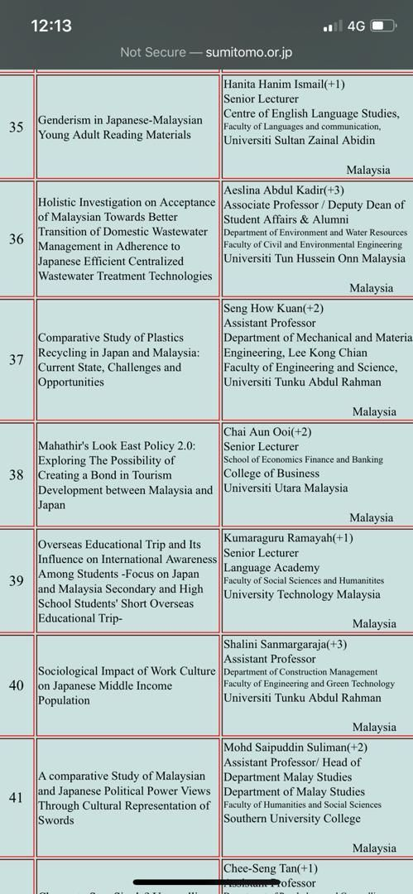

Slide 20
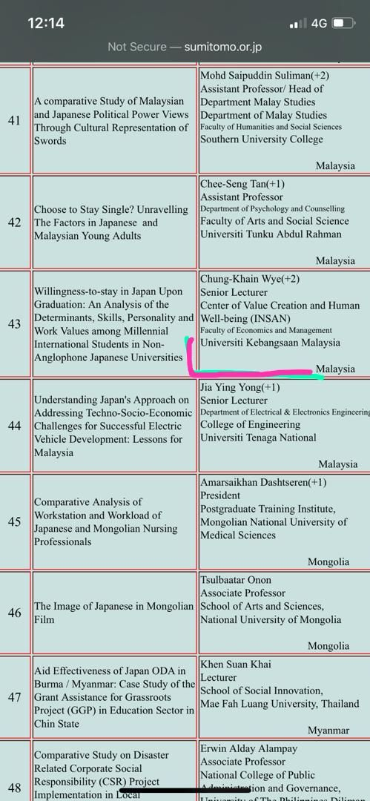

Slide 21
Personal Experiences
Requirements | TIPS | Note
Any research project, mainly in the field of social sciences or humanities that is related to Japan. | Kaitkan dengan apa yang kita boleh belajar dari Jepun, ATAU Impact Jepun ( policy, pelaburan dll) ke atas negara lain | TIMSS Lesson Study Origami Doremon Preservation of Arts Water waste management Disaster Risk Reduction Smart Society- IoT Browse and find
 | Categories | Special needs Women Migrants

Slide 22
Requirements | TIPS | Note
Visits to Japan | Need to find collaborators OR Conduct meeting with experts in Japan | Agreement of collaborator through email is sufficient.
Summary of Research | Can be in English or Japanese

Slide 23
Requirements | TIPS | Note
Budget- Maximum is USD 16 000 | Be realistic in budget RA for certain months only not through out the project. | USD 16000 reduced to USD 9100.
Success rates | 480 proposals 64 granted (2018) 649 proposals ( 17 countries), 67 projects awarded (2019)

Slide 25
Semoga Berjaya

